Slide 1


All American Athletes
Region & National Champion Teams
_{1960’s}
₁₉₈₀ ₋ ₁₉₈₅
₁₉₉₀ ₋ ₁₉₉₅
₂₀₀₀ ₋ ₂₀₀₃
₂₀₀₇ ₋ ₂₀₀₉
_{1970’s}
₁₉₈₆ ₋ ₁₉₈₉
₁₉₉₆ ₋ ₁₉₉₉
₂₀₀₄ ₋ ₂₀₀₆
₂₀₁₀ ₋ ₂₀₁₆
₂₀₁₇ ₋ ₂₀₂₀
Men’s Sports
Women’s Sports
Baseball | Basketball
Football | Golf
Tennis | Track & Field
Wrestling 70’s – 80’s | Wrestling 90’s
Wrestling 00’s – 10’s
Basketball | Softball
Tennis | Track & Field
Volleyball 80’s – 00’s | Volleyball 10’s

Slide 2

Baseball
Dan Carlson ‘90
Dave Burkholder ‘99
David Buss ’99
Joe Bailey ‘00
Andy Garry ‘02
Adam Beyer ‘03
Chris Nelson ’03
Dan Berg ‘04
Nate Hebrink ‘04
Adam Ferrell ‘05
Jamie Terres ‘05
Zach Etter ‘06
Keaton Gustin ‘07
Matt Bauer ‘07
Matt Bauer ’08
Shane Kampsen ‘10
Back to main page

Slide 3
Basketball
Abe Gibbons ’69
Charlie Williams ‘70
Jim Hedstrom ‘88
Tim Holthaus ‘94
Scott Koenen ‘98
Trevor Duevel ‘99
Mandi Illies ‘00
Katie Dale ‘01
Jennie Kuehn ‘02
Jes Rusten ‘02
Krista Rambow ‘04
Terra Billet ‘06
Hilary Groothuis ‘08
Akeem Oglesby ‘15
Erica Melbie ’15
Akeem Oglesby ‘16
Back to main page

Slide 4
Football
Chuck Kavanagh ’68
Al Nowak ’69
Tom Waltower ‘70
Dan Commerford ‘72
Rich Roster ’73
Rick Reimer ‘78
Tim Anderson’78
Brian Butch Suter ‘80
Al Molitor ‘81
Steve Voss ‘82
Danny Johnson ‘85
Jon Johnson ‘86
Terry Ullom ‘87
Dan Carlson ‘89
Tab Erickson ’89
Doug Doering ‘90
Tom Kuechle ‘91
Brian Prestholdt ‘92
Kevin Fier ‘94
Jeremy Lee ‘97, ’98
Adam Biggar ‘01
Chad Strike ‘04
Tony Kley ‘05
Alex McLaughlin ‘08
Kevin Parks ’14
Jaquon Cogshell ‘16
John McClure ‘17
Back to main page

Slide 5
Golf
Tim Dreier ‘08
Back to main page

Slide 6
Softball
Gail Winkelman ‘89
Jill Holz ’89
Sue Varland ‘91
Wendy Gartner ’91
Lori Feltman ‘03
Lori Feltman ‘04
Julie Vosejpka ‘05
Julie Vosejpka ‘06
Kristen Hegna ‘07
Laura Suter ’07
Emily Roelike ‘10
Brandi Bodin ‘11
Emily Roelike ‘11
Heather Horning ’15
Jacie Selseth ‘15
Back to main page

Slide 7
Tennis
Abby Martins ’03
Kristin Gillis ’03
Abby Martins ‘04
Kristine Hagedorn ‘04
Lisa Meyer ‘04
Jessica Enger ’05
Kali Gravgaard ‘05
Erika Swenson ‘97
Hayley Horning ’97
Heather Kuechle ‘97
Joy Bohlsen ‘97
Megan Bents ’97
Ben Jacobson ’99
Back to main page

Slide 8
Track & Field
Bonnie Schwegel ‘81
Lisa Jorgenson ‘84
Mike Ashburn ‘87
Back to main page

Slide 9
Volleyball 80’s – 00’s
Barb Kramer ‘82
Arliss Tensen ‘85
Sadie Nordstrom ‘97
Erica Olson ‘98
Jackie Robinson ’98
Jill Braaten ‘98
Rachel Penny ’98
Anna Ackerson ’01
Stephanie Buboltz ‘01
Stephanie Buboltz ’02
Vicki Buseman ‘02
Katie Jerve ‘03
Kristin Raitz ’05
Terra Billiet ’05
Ashley Olson ‘06
Jackie Noyes ‘06
Hilary Groothuis ‘08
Leah Miller ‘08
Stephanie Tillman ‘08
Emily Roelike ‘09
Macy McKay ‘09
Stephanie Tillman ‘09
Back to main page

Slide 10
Volleyball 10’s
Emily Roelike ’10
Macy McKay ‘10
Molly Hurrle ’10
Hannah Smith ’11
Kelsey Stommes ’11
Molly Hurrle ‘11
Kelsey Stommes ‘13
Tiffani Karbo’13
Tiffani Karbo ‘14
Jen Puncochar ‘14
Brenna Olsen ‘15
Kaitlyn Sterner ‘16
Natalie Feldhake ’16
Baylie Kubesh ‘16
Hailey Leiding ‘16
Cami Seletta ‘17
Back to main page

Slide 11
Wrestling 70s’ – 80’s
Ken Vogt ‘72
Lon Kvanli ‘77
Kelly Aalfs ’78
Dave Kofoed ‘80
Tim Anderson ’81
Rick Dorn ‘82
Kyle Presler ’83
Mark Woitalla ‘83
Steve Voss ’83
Allan Bastian ‘84
Scott Dyer ‘84
Dave Christianson ‘85
Mike Schmitz ’85
Doug Bonk ‘86
Greg Schmitz ’88
Nick Jennissen ‘87
Rick Valli ’87
Terry Ullom ‘87
Dale Herbst ‘88
Kris Presler ‘88
Dave Haas ‘89
Jim Soine ‘89
Back to main page

Slide 12
Wrestling 90’s
Bill Gabler ‘ 90
Troy Johnson ‘90
TJ Frantz ‘91
Troy Haglund ‘92
Aaron Swanson ‘93
Brian Hellman ‘93
Mike McDougall ‘94
Todd Hodnefield ‘94
Tony Kenning ‘94
Ben Schrupp ‘95
Chad Kranz ‘95
Scott Sachariason ‘95
Bruce Kenning ‘96
Jay Mahoney ‘96
Jeff Barrett ‘96
Brandon Holmberg ‘97
Jesse Bakalyar ‘97
Brian Beste ‘98
Luke Wren ‘98
Paul Arens ‘98
Aaron Vogt ‘99
Jason Fratzke ‘99
Lance Harpster ‘99
Lee Hiltner ‘99
Back to main page

Slide 13
Wrestling 00’s – 10’s
Lee Hiltner ‘00
Jake Eligin ’01
Carey Vanier ‘02
Josh Janousek ‘02
Lukas Pohlmeier ‘02
Nate Schut ‘02
Corey Feltmann ‘03
Josh Janousek ‘03
John Koons ‘04
Travis Birhanzl ‘04
Ethan Vogt ‘05
Jarret Hall ‘05
Jeremy Sogge ‘05
Tim Johnson ‘05
Dusty Myers ‘06
Ethan Vogt ‘06
Brandon Schunk ‘07
Jarret Hall ‘07
Justin Turek ‘07
Brandan Schunk ’08
Chase Temple ’10
Travis Peralta ‘10
Travis Peralta ‘11
Chris Schmidt ’16
Zach Revier ’16
Mark Voss ‘18
Back to main page

Slide 14
1960 - 1969
Chuck Kavanagh ’68 – Football
Abe Gibbons ‘69
-Basketball
Al Nowak ’69
- Football
Back to main page

Slide 15
1970 - 1979
Charlie Williams ‘70
- Basketball
Tom Waltower ’70
- Football
Don Commerford ’72
– Football
Ken Vogt ‘72 -Wrestling
Rich Roster ’73 –Football
Lon Kvanli ‘77 –Wrestling
Kelly Aalfs ‘78 –Wrestling
Rick Reimer ’78 -Football
Tim Anderson ’78 -Football
Back to main page

Slide 16
1980 - 1985
Brian Butch Suter ’80 – Football
Dave Kofoed ‘80 – Wrestling
Al Molitor ’81 – Football
Bonnie Schwegel ‘81 – Track
Tim Anderson ‘81 - Wrestling
Barb Kramer ‘82 – Volleyball
Rick Dorn ‘82 - Wrestling
Steve Voss ’82 – Football
Mark Woitalla ‘83 – Wrestling
Steve Voss ‘83 – Wrestling
Allan Bastian ‘84 - Wrestling
Lisa Jorgenson ‘84 – Track
Scott Dyer ‘84 - Wrestling
Arliss Tensen ’85 - Volleyball
Danny Johnson ’85 - Football
Mike Schmitz ‘85 – Wrestling
Back to main page

Slide 17
1986 - 1989
Doug Bonk ‘86 - Wrestling
Jon Johnson ’86 – Football
Greg Schmitz ’87 - Wrestling
Mike Ashburn ‘87 – Track
Nick Jennissen ‘87 –Wrestling
Rick Valli ‘87 – Wrestling
Terry Ullom ’87 - Football
Terry Ullom ’87 - Wrestling
Dale Herbst ’88
– Wrestling
Greg Schmitz ‘88 - Wrestling
Jim Hedstrom ‘88 – Basketball
Kris Presler ‘88
– Wrestling
Dan Carlson ’89 – Football
Dave Hass ’89 - Wrestling
Gail Winkelman ‘89 – Softball
Jill Holtz ’89 – Softball
Jim Soine ‘89 - Wrestling
Tab Erickson ’89 - Football
Back to main page

Slide 18
1990 - 1995
Bill Gabler ‘90 - Wrestling
Dan Carlson ’90 – Baseball
Doug Doering ‘90 – Football
Troy Johnson ‘90 - Wrestling
Sue Varland ‘91 – Softball
TJ Frantz ‘91 - Wrestling
Tom Kuechle ‘91 – Football
Wendy Gartner ‘91 – Softball
Brian Prestholdt ’92– Football
Troy Haglund ‘92 – Wrestling
Aaron Swanson ‘93 – Wrestling
Brian Hellman ‘93 - Wrestling
Kevin Fier ‘94
– Football
Mike McDougall ‘94 – Wrestling
Tim Holthaus ‘94 –Basketball
Todd Hodnefield ’94 – Wrestling
Tony Kenning ‘94 – Wrestling
Ben Schrupp ‘95 – Wrestling
Chad Kranz ‘95 – Wrestling
Scott Sachariason ‘95 – Wresting
Back to main page

Slide 19
1996 - 1999
Bruce Kenning ’95-’96 – Wrestling
Jay Mahoney ’95-’96 – Wrestling
Jeff Barrett ’95-’96 – Wrestling
Jessie Bakalyar ’95-’96 - Wrestling
Brandon Holmberg ’96-’97 – Wrestling
Erika Swenson ’96-’97 – Tennis
Hayley Horning ’96-’97 – Tennis
Heather Kuechle ‘97 – Tennis
Joy Bohlsen ’96-’97 – Tennis
Megan Bents ’96-’97 – Tennis
Jeremy Lee ’97-’98 – Football
Brian Beste ‘97-‘98 – Wrestling
Luke Wren ‘97-‘98 – Wrestling
Paul Arens ‘97-‘98 - Wrestling
Sadie Nordstrom ’97-’98 – Volleyball
Erica Olson ’97-’98 – Volleyball
Jackie Robinson ‘98 – Volleyball
Jill Braaten ‘98 – Volleyball
Rachel Penny ‘98 - Volleyball
Scott Koenen ’97-’98 – Basketball
Aaron Vogt ’98-’99 - Wrestling
Ben Jacobson ’98-’99 - Tennis
Dave Buckholder ’98-’99 – Baseball
David Buss ’98-’99 – Baseball
Jason Fratzke ’98-’99 - Wrestling
Lance Harpster ’98-’99 – Wrestling
Lee Hiltner ’99-’00 - Wrestling
Trevor Duevel ’98-’99 – Basketball
Back to main page

Slide 20
2000 - 2003
Joe Bailey ‘00 – Baseball
Lee Hiltner ‘00 - Wrestling
Mandi Illies ‘00 –Basketball
Adam Biggar ‘01- Football
Anna Ackerson ‘01 – Volleyball
Katie Dale ‘01 – Basketball
Jake Eligin ‘01 - Wrestling
Stephanie Buboltz ‘01, - Volleyball
Stephanie Buboltz ’02 - Volleyball
Andy Garry ‘02 - Baseball
Casey Vanier ’02 - Wrestling
Jennie Kuehn ‘02 – Basketball
Jes Rusten ‘02 – Basketball
Josh Janousek ‘02 - Wrestling
Lori Feltman ‘02 – Softball
Lukas Pohlmeier ’02 - Wrestling
Nate Schut ’02 - Wrestling
Vicki Buseman ‘02 – Volleyball
Abby Martins ‘03
- Tennis
Adam Beyer ‘03 - Baseball
Chris Nelson ‘03 – Baseball
Corey Feltmann ’03 – Wrestling
Josh Janousek ‘03 – Wrestling
Katie Jerve ‘03 – Volleyball
Kristin Gillis ‘03
- Tennis
Back to main page

Slide 21
2004 - 2006
Abby Martins ‘04 – Tennis
Dan Berg ‘04 – Baseball
Chad Strike ‘04 - Football
Jen Puncochar ‘04 - Volleyball
John Koons ‘04 – Wrestling
Krista Rambow ‘04 – Basketball
Kristine Hagedorn ‘04
– Tennis
Lisa Meyer ‘04 - Tennis
Lori Feltman ‘04 – Softball
Nate Hebrink ‘04 - Baseball
Travis Birhanzl ’04 - Wrestling
Adam Ferrel ’05 - Baseball
Ethan Vogt ‘05 – Wrestling
Jamie Terres ’05 - Baseball
Jarret Hall ‘05 – Wrestling
Jeremy Sogge ‘05 – Wrestling
Jessica Enger ‘05 - Tennis
Julie Vosejpka ’05 – Softball
Kali Gravgaard ‘05 - Tennis
Kristin Raitz ‘05 – Volleyball
Terra Billiet ‘05 - Volleyball
Terra Billet ’05 - Basketball
Tim Johnson ‘05 – Wrestling
Tony Kley ’05 - Football
Ashley Olson ‘06 – Volleyball
Dusty Myers ‘06 – Wrestling
Ethan Vogt ‘06 - Wrestling
Jackie Noyes ‘06 - Volleyball
Julie Vosejpka ’06 – Softball
Zach Etter ’06 - Baseball
Back to main page

Slide 22
2007 - 2009
Brandon Schunk ‘07 – Wrestling
Jarret Hall ‘07 – Wrestling
Justin Turek ‘07 – Wrestling
Keaton Gustin ‘07 - Baseball
Kristen Hegna ‘07 – Softball
Laura Suter ‘ 07 – Softball
Matt Bauer ‘07 - Baseball
Alex McLaughlin ’08 - Football
Brandan Schunk ‘08 – Wrestling
Hilary Groothuis ‘08 – Basketball
Hilary Groothuis ‘08 – Volleyball
Leah Miller ‘08 – Volleyball
Matt Bauer ‘08 - Baseball
Stephanie Tillman ‘08 – Volleyball
Tim Dreier ‘08 - Golf
Emily Roelike ‘09 – Volleyball
Macy McKay ‘09 – Volleyball
Stephanie Tillman ‘09 - Volleyball
Back to main page

Slide 23
2010 - 2016
Chase Temple ‘10 - Wrestling
Emily Roelike ‘10 – Volleyball
Emily Roelike ‘10 - Softball
Macy McKay ‘10 – Volleyball
Molly Hurrle ‘10 - Volleyball
Shane Kampsen ‘10 - Baseball
Travis Peralta ‘10 – Wrestling
Brandi Bodin ‘ 11 – Softball
Emily Roelike ‘ 11 - Softball
Hannah Smith ‘11 – Volleyball
Kelsey Stommes ‘11 – Volleyball
Molly Hurrle ‘ 11 - Volleyball
Travis Peralta ’11 - Wrestling
Kelsey Stommes ‘13 – Volleyball
Tiffani Karbo ‘13 – Volleyball
Tiffani Karbo ‘14 – Volleyball
Kevin Parks ‘14
– Football
Brenna Olsen ‘15 – Volleyball
Heather Horning ‘ 15 – Softball
Jacie Selseth ‘15
- Softball
Akeem Oglesby ‘16 – Basketball
Chris Schmidt ‘ 16 - Wrestling
Erica Melbie ‘16 - Basketball
Kaitlyn Sterner ‘16 – Volleyball
Natalie Feldhake ‘16 – Volleyball
Zach Revier ‘16
- Wrestling
Back to main page

Slide 24
2017 - 2020
Cami Seletta ’17 – Volleyball
John McClure ‘17 - Football
Matt Voss ’18 -Wrestling
Back to main page

Slide 25

All American Athletes
Baseball

Slide 26
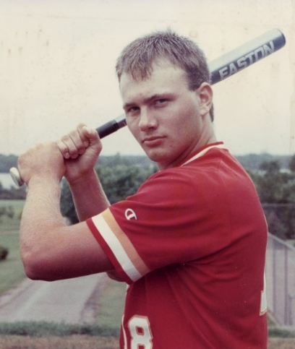
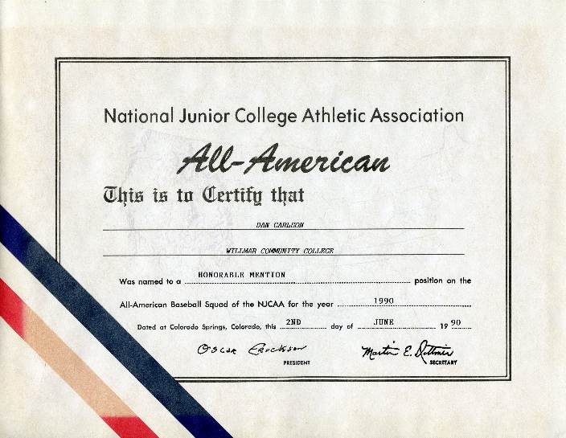
Dan Carlson
WCC
Honorable Mention, All-Region 13 ’89,
All-MCCC ’89, All-Region 13 ’90,
All-MCCC ‘90
1990

Slide 27

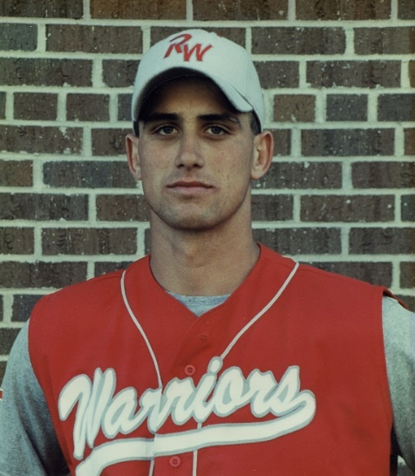
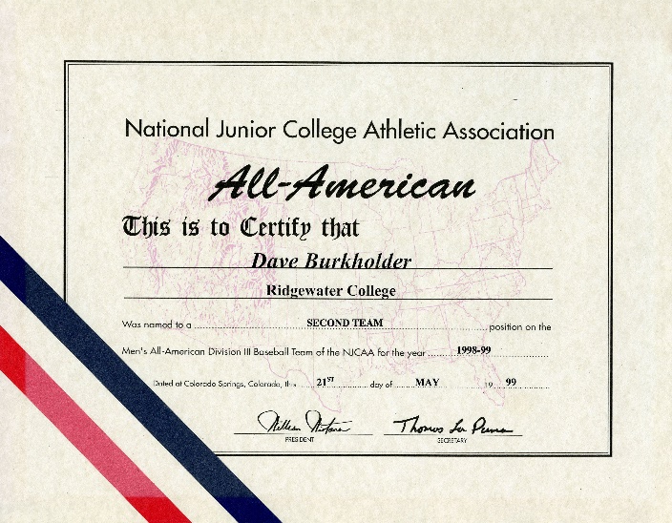
Dave Burkholder
Second Team, All-Region 13 ’89, All-Region 13 ‘99, MCCC Southern Division Player of the Year ’99
1998-1999
1999 Statistics
.484 BA
10 HR
11 2B
43 RBI’s
4-1 pitching
4.08 ERA
31 SO

Slide 28
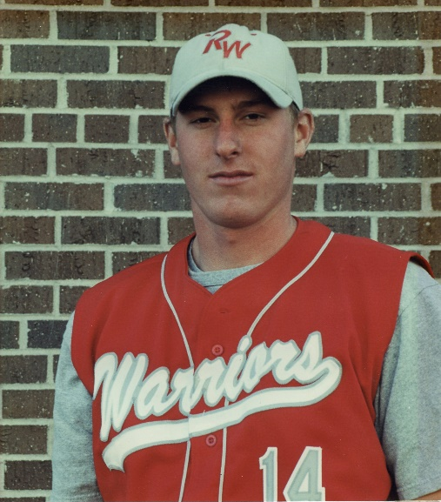
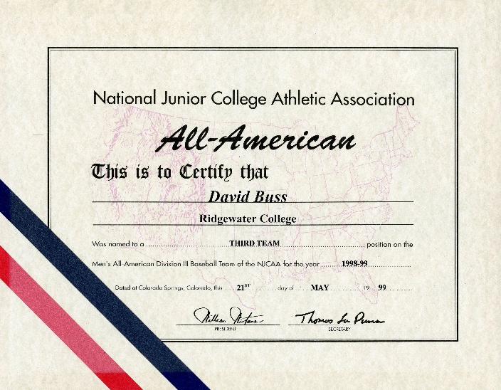
Dave Buss
Third Team, All-Region 13 ‘99
1998-1999
1999 Statistics
8-1 record
1.59 ERA
50 SO

Slide 29
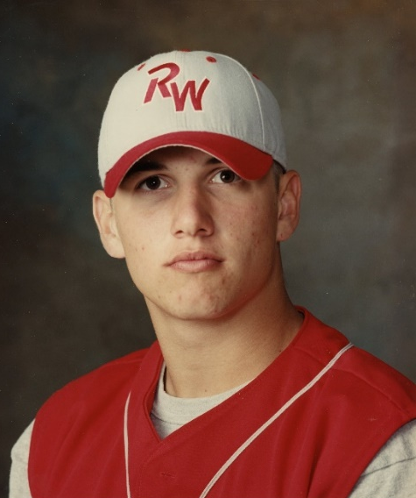
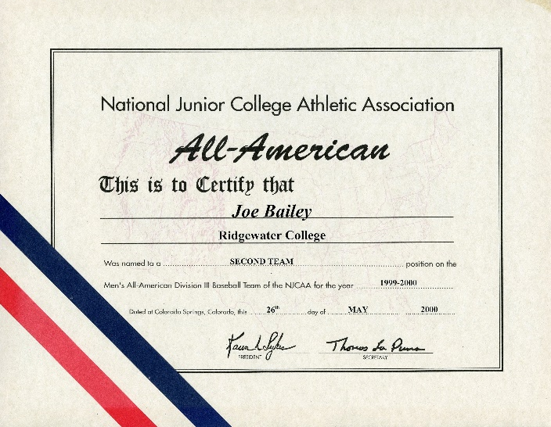
Joe Bailey
Second Team, All-MCCC ‘00;
1st Team All-Southern Division ’00,
1st Team All-Region 13 ’00
1999-2000
Catcher
.463 BA
27 RBIs
7 SB’s
15 stolen bases

Slide 30
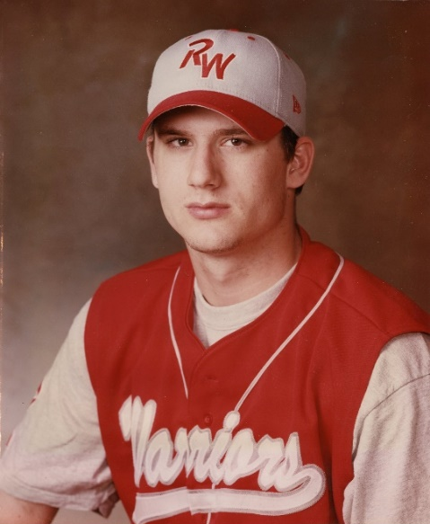
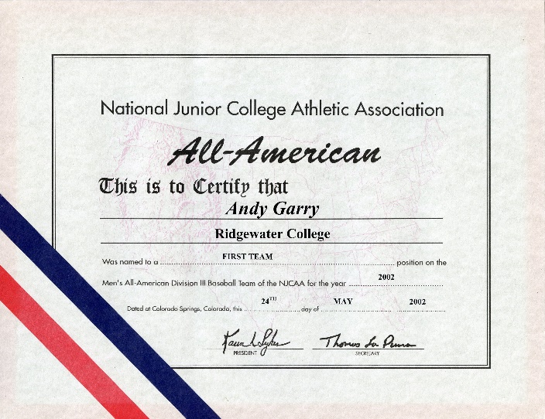
Andy Garry
First Team, MCCC Player of the Year ’02,
All-Southern Division ’02, All-MCCC ‘02
2002
Right Handed Pitcher
2001 stats
6W 3L
2.14 ERA
2002 stats
9W 1L
1.41 ERA

Slide 31
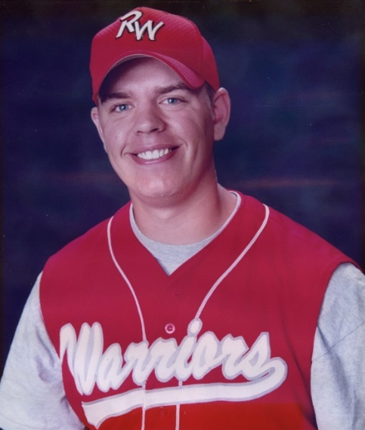
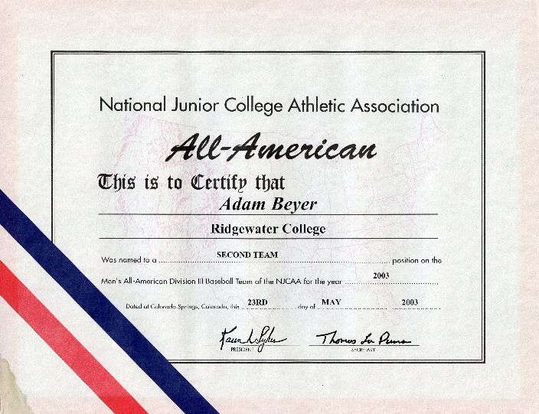
Adam Beyer
Second Team, All-MCCC ’03, All-Region 13 ’03, All-Southern Division ’03, Southern Division Player of the Year ’03
2003
First Base
2002 stats
.389 BA
6 2B
2 HR
23 RBI
2003 stats
.411 BA
16 2B
1 3B
10 HR
58 RBI

Slide 32
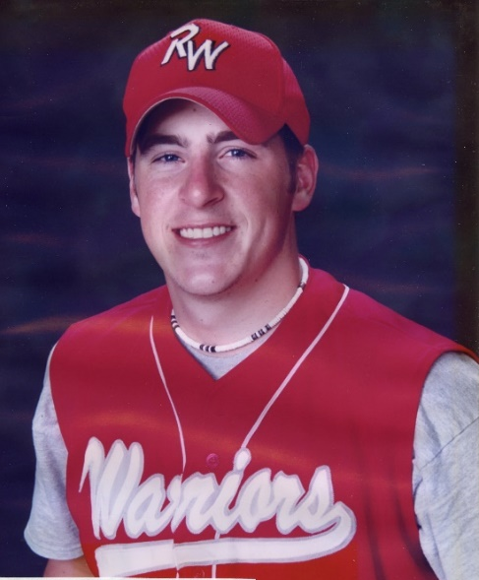
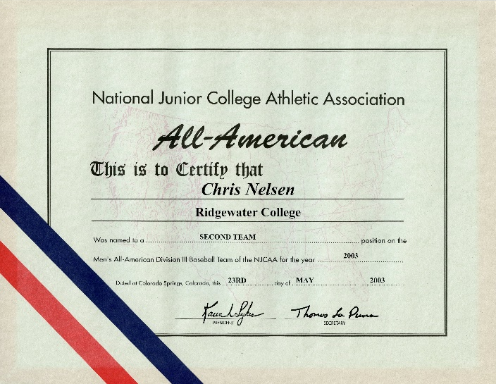
Chris Nelson
Second Team, All-Southern Division ’03,
All-MCCC ’03, All-Region ‘03
2003
Right Handed Pitcher
2002 stats
6 W 2L
2.47 ERA
76 Innings
55 Strike Outs
2003 stats
9W 3L
1.39 ERA
59 Innings
81 Strike Outs

Slide 33
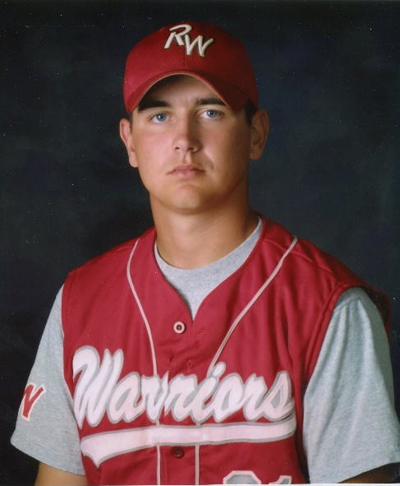
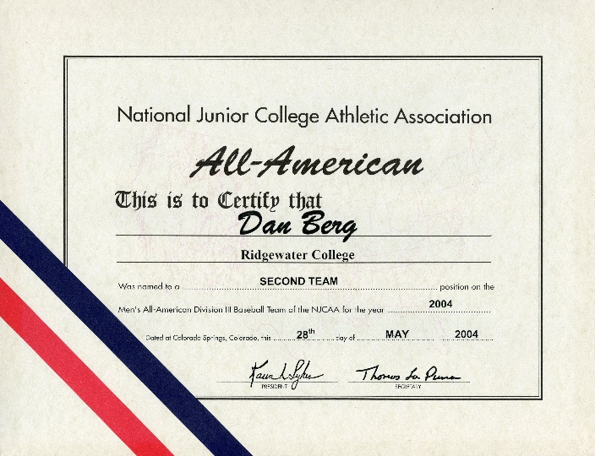
Dan Berg
Second Team, All-Southern Division ’04,
All-MCCC ’04, All-Region 13 ’04
2004
Outfield
2004 stats
.449 BA
53 Runs
6 2B
2 3B
32 RBI
16 – 18 SB

Slide 34
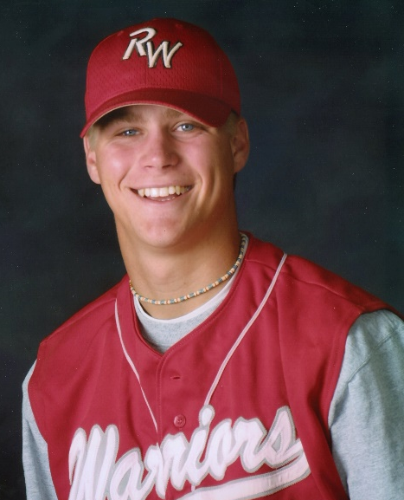
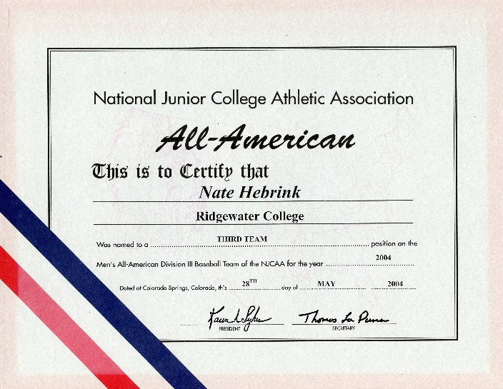
Nate Hebrink
Third Team, All-Southern Division ’04, Southern Division Player of the Year ’04,
All-Region 13 ’04, All-MCCC
2004
Right Handed Pitcher
9 W 3L
2.25 ERA
80 2/3 INN
83 SO

Slide 35
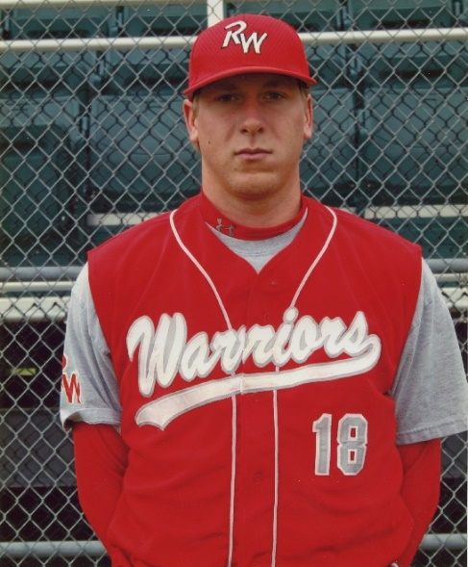
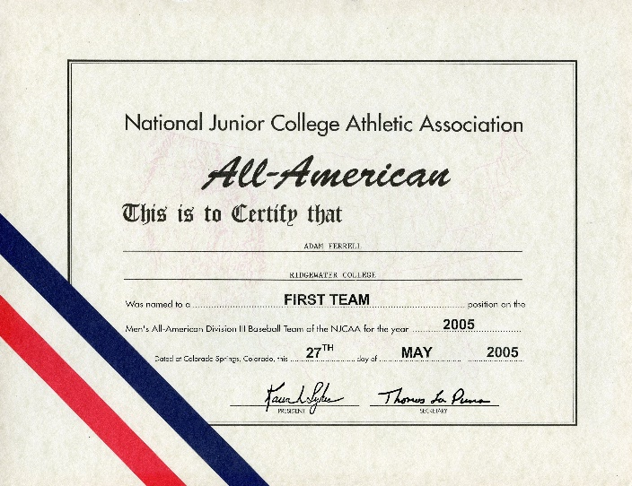
Adam Ferrell
First Team, All-Region 13 ’05,
MCCC Player of the Year ’05
2005
Pitcher
8W 1L
1.56 ERA
75 SO
49 1/3 IP

Slide 36
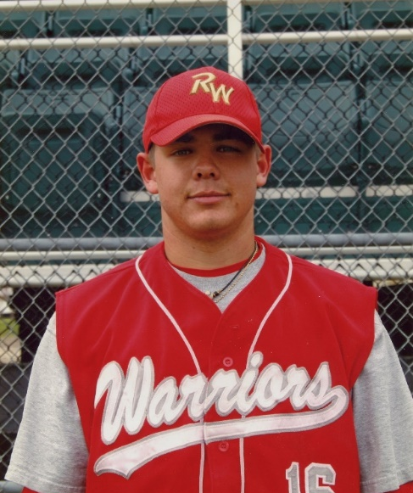
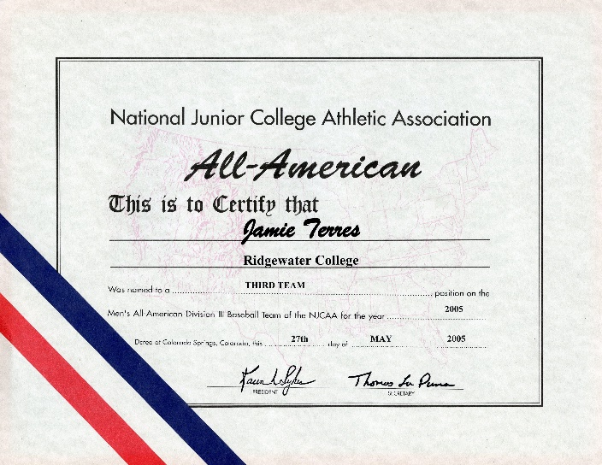
Jamie Terres
Third Team, All-Region 13 ’05, All-MCCC ‘05
2005
Second base
.434 BA
4 HR
43 RBI

Slide 37
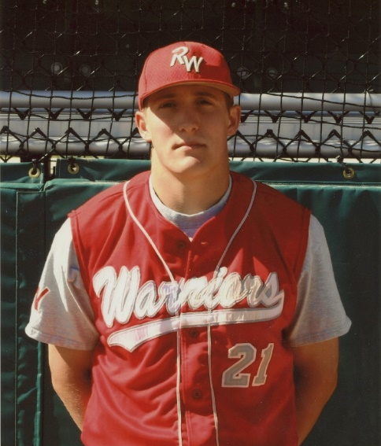
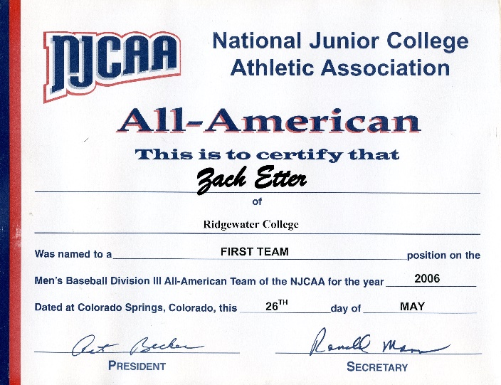
Zach Etter
First Team, All-Region 13 ’06,
Southern Division Player of the Year ‘06
2006
Outfield / Pitcher
.398 BA
10 2B
5 HR
19 SB
26 RBI
Pitching
5 W - 0L
2.21
3 Saves

Slide 38
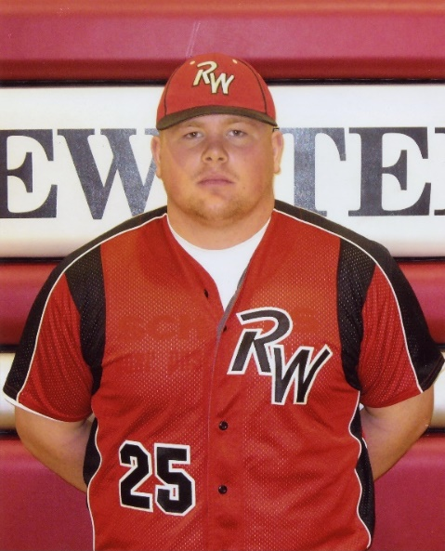
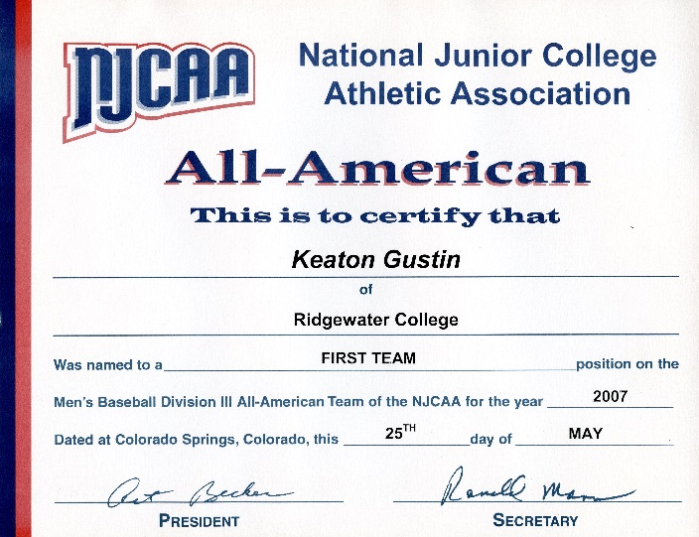
Keaton Gustin
Second Team, MCCC Player of the Year ’07, Region 13 Player of the Year ‘07
2007
First Base
.403 BA
9 HR
51 RBI

Slide 39
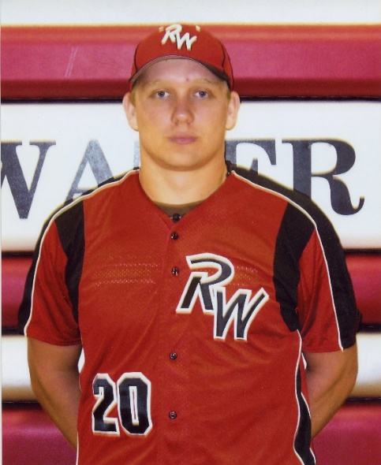
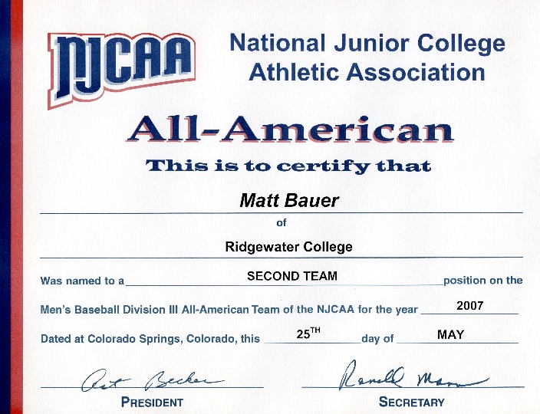
Matt Bauer
Second Team
2007
Designated Hitter
.405 BA
7 2B
7 HR
38 RBI

Slide 40
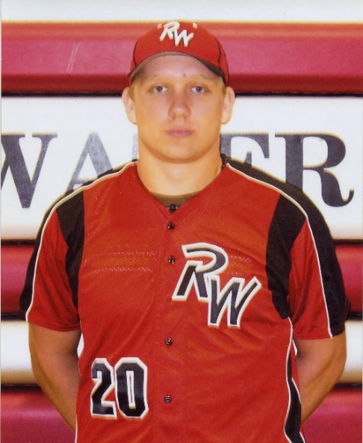
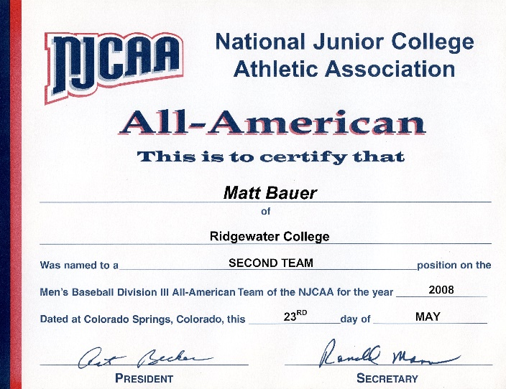
Matt Bauer
Second Team, Southern Player of the Year ’08, All-MCCC ’08, All-Region 13 ‘08
2008
Third Base
.456 BA
22 2B
4 HR
56 RBI

Slide 41
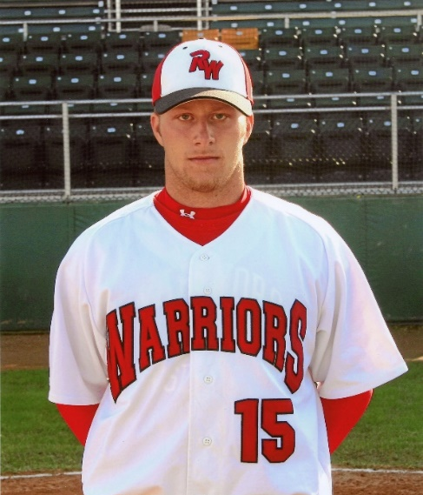
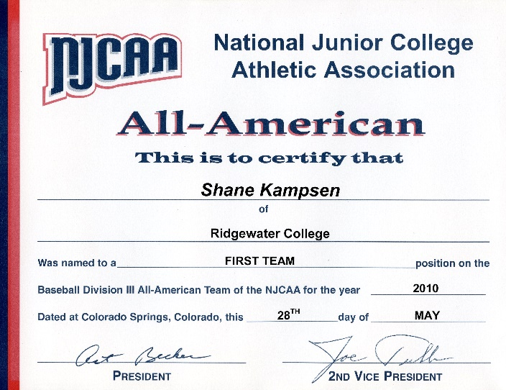
Shane Kampsen
First Team, MCAC Player of the Year,
MCAC Central Division Player of the Year ‘10
2010
Center
.530 BA
62 Hits
14 2B
7 3B
6 HR
40 Runs
.583 OB%

Slide 42
All American Athletes
Basketball

Slide 43
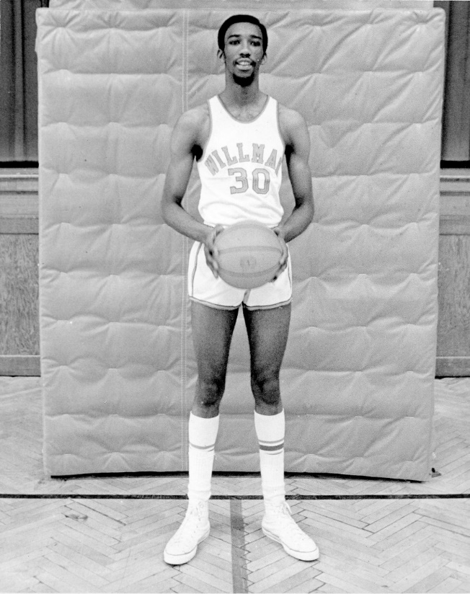
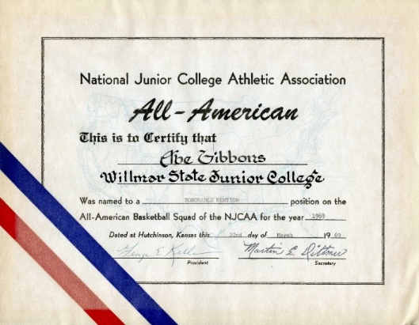
Abe Gibbons
WSJC
Honorable Mention
1969
Back to main page

Slide 44
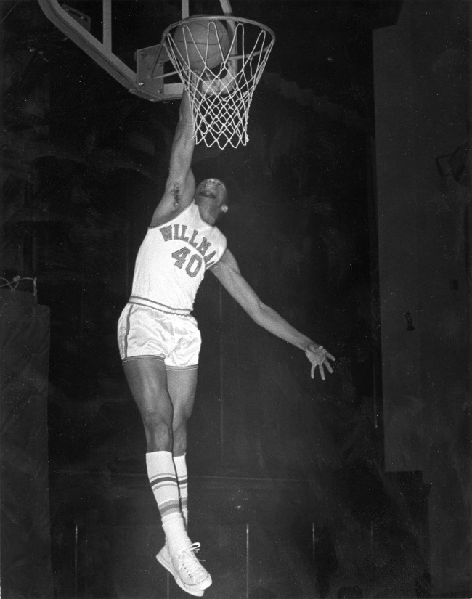
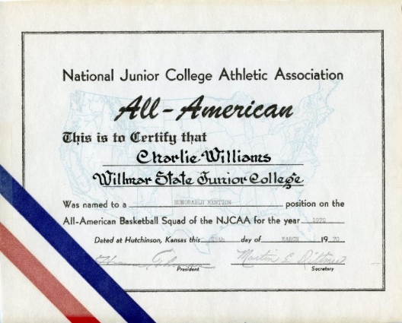
Charlie Williams
WSJC
Honorable Mention
1970
Back to main page

Slide 45
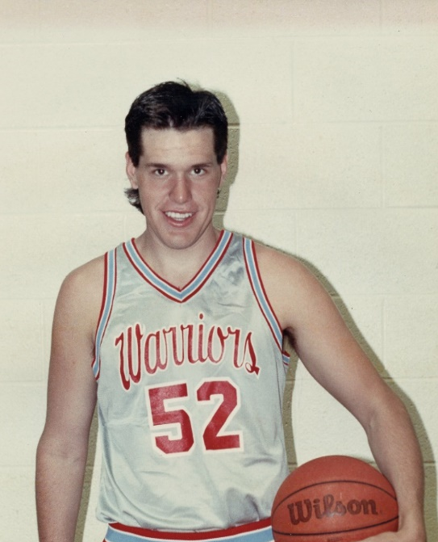
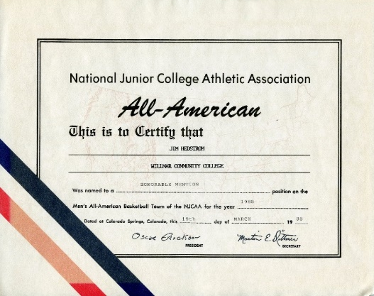
Jim Hedstrom
WCC
Honorable Mention, All-Region 13 ’87,
All-MCCC ‘87, All-Region 13 ’88, All-MCCC ‘88
1988
Warrior MVP ‘88
Free throw champion ‘87
Back to main page

Slide 46
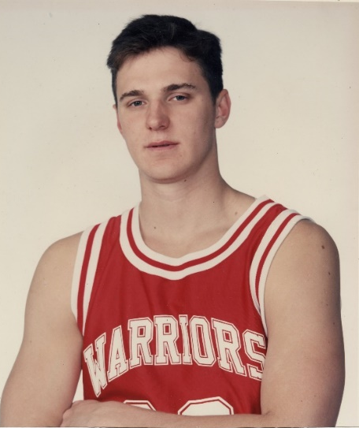
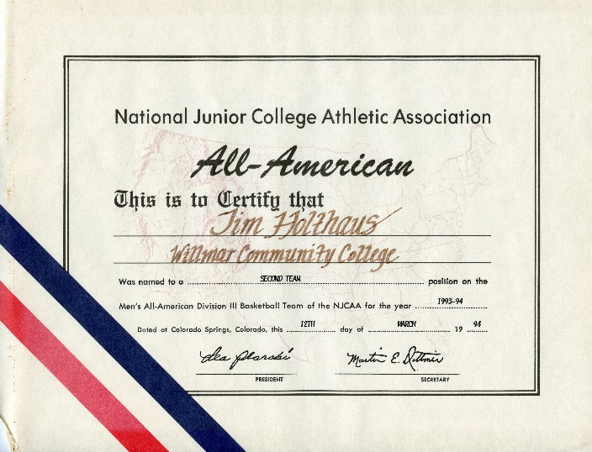
Tim Holthaus
WCC
Second Team, All-MCCC ’93; All-Conference ’93, All-MCCC ’94, All-Conference ’94, Region-13 ‘94
1993-1994
MVP ‘93
Team captain ’94
Averaged 17.7 points per game & 9 rebounds per game

Slide 47
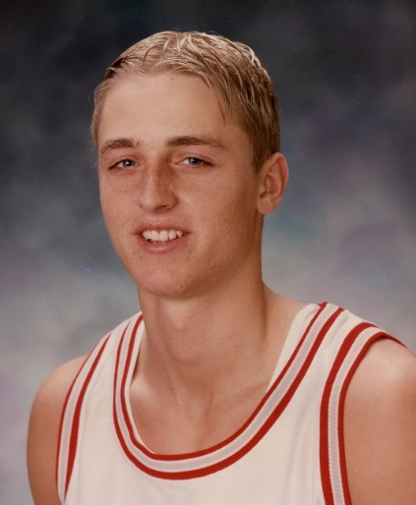
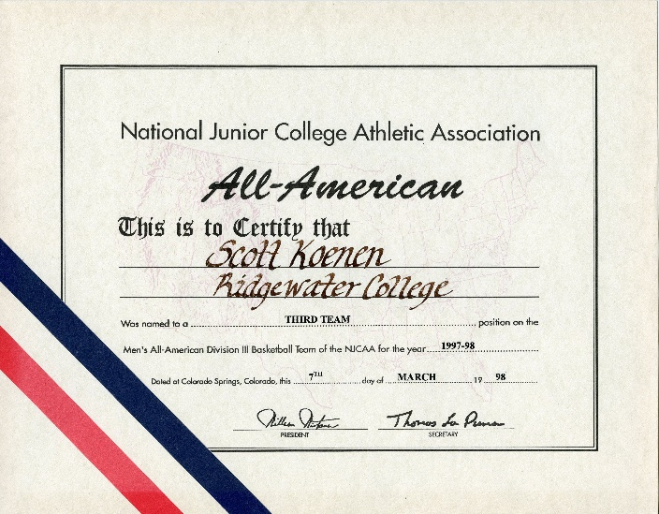
Scott Koenen
Third Team, All-Region 13 ’97,
MCCC All-State ’97
1997-1998
Team MVP
Averaged 22 points per game

Slide 48
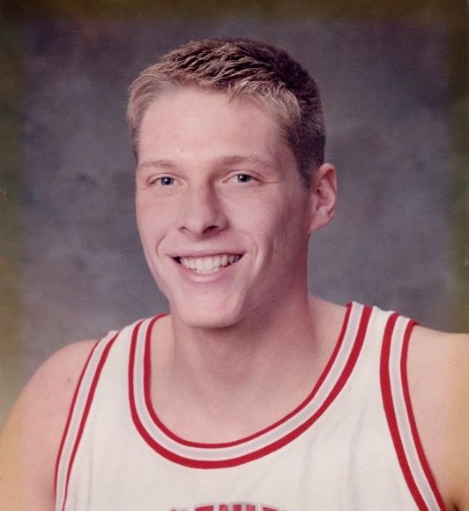
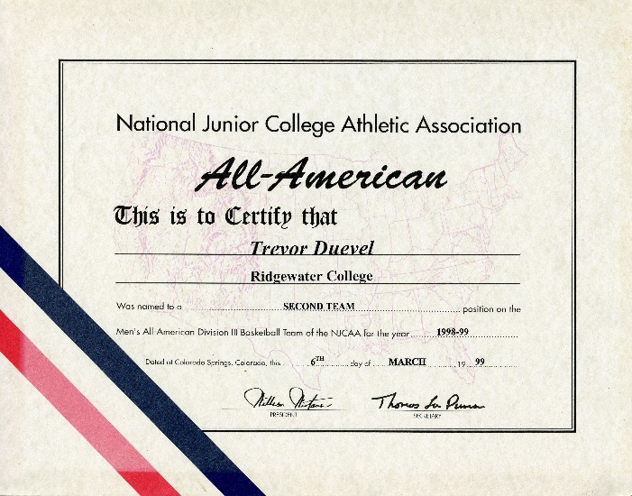
Trevor Duevel
Second Team, All-MCCC ’98, All-Region 13 ’98
1998-1999
Team captain
Team MVP
Averaged 15.6 points per game & 12.5 rebounds per game
Game high of 28 rebounds

Slide 49
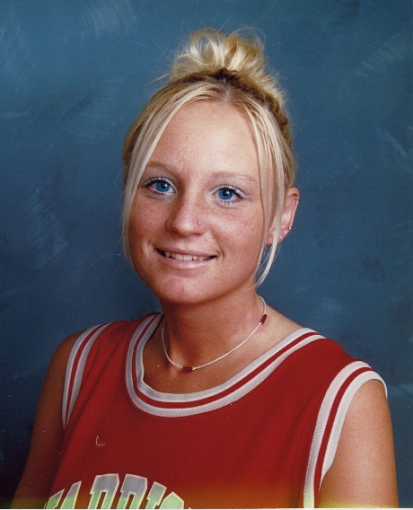
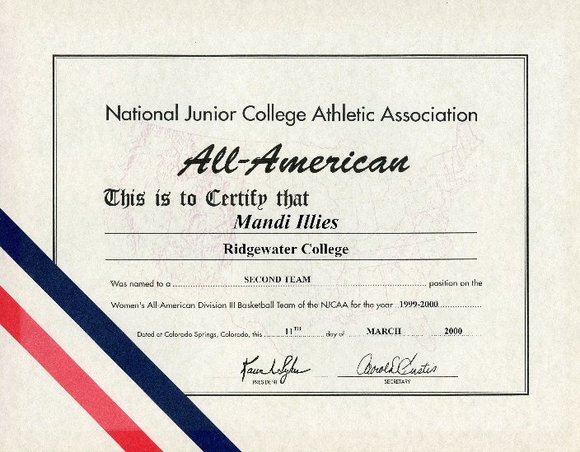
Mandi Illies
Second Team, All MCCC, All-Region 13
All State Tournament ’99,
All State Tournament ‘00;
1999-2000
Post
1998-1999 stats
18.2 PPG
7.5 RPG
1999-2000 stats
18.3 PPG
8.1 RPG

Slide 50
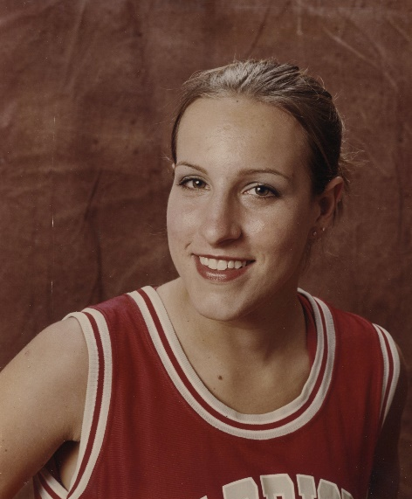
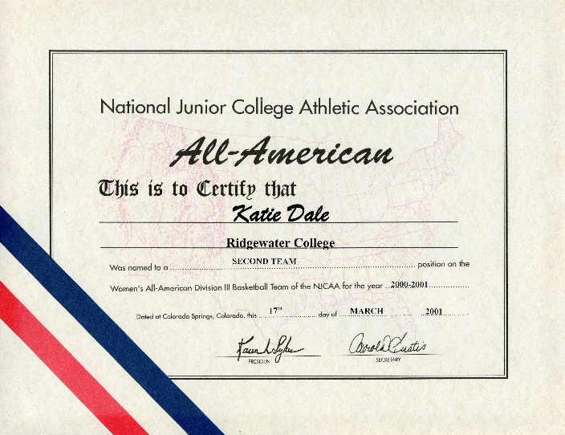
Katie Dale
Second Team, All-Region 13, All-Southern Division, All MCCC, All State & Region Tournament Teams
2000-2001
Point Guard
1999-2000 stats
9.1 PPG
4.0 APG
2.0 SPG
Team MVP
2000-2001 stats
8.5 PPG
5.2 APG
4.5 SPG

Slide 51
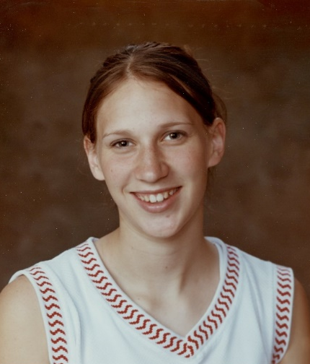
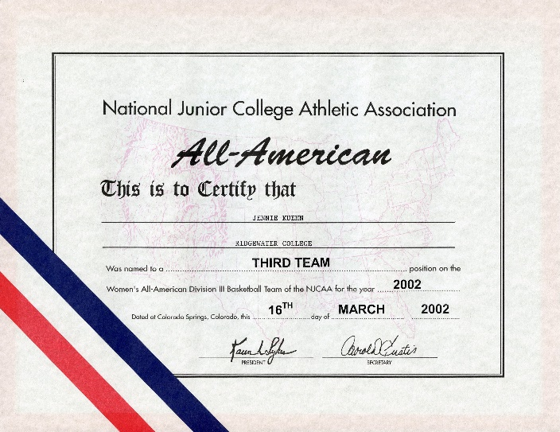
Jennie Kuehn
Third Team, All-Region 13, All-MCCC, All-Southern Division, All MCCC, Region 13 & NJCAA Tournament
2002
Post
2000-2001 stats
13.9 PPG
8.9 RPG
2.0 BPG
2001-2002 stats
20.4 PPG
10.6 RPG
3.0 BPG
Career School Records
989 points, 559 rebounds

Slide 52


Jes Rusten
Honorable Mention, All-Region 13, All-MCCC, All Southern Division, All MCCC & Region 13 Tournament
2002
Guard
2000-2001 stats
12.5 PPG
3.9 APG
7.8 RPG
3.9 SPG
2001-2002 stats
13.8 PPG
6.8 APG
7.8 RPG
3.9 SPG

Slide 53


Krista Rambow
Honorable Mention, All-Region 13, All-MCCC, All-Southern Division
2005
Wing
2004-2005 stats
12 PPG
6.2 RPG
2.1 SPG

Slide 54


Terra Billiet
Third Team, All-Region 13, All-MCCC,
All-Southern Division State Tournament
2006
Post
2004-2005 stats
13.6 PPG
7.5 RPG
2005-2006 stats
14.1 PPG
9.8 RPG

Slide 55


Hilary Groothuis
Third Team, All-Southern Division, All-MCCC;
All-Region 13, All-MCCC State Tournament
2008
Post
2006-2008 stats
50 games
819 points (16.4 PPG)
426 rebounds (9 RPG)

Slide 56


Akeem Oglesby
Second Team, Region 13 Player of the Year ’16, All-Region Team ’16, All-MCAC Team ’16,
All-MCAC Southern Division Team, MCAC Player of the Week four times ’16
2015-2016
Point Guard
2016 stats
612 Points (20.4 PPG)
148 Assists (4.9 APG)
175 Rebounds (5.8 RPG)
38 Steals (1.3 SPG)

Slide 57


Erica Melbie
Second Team
2015-2016
20 Points per game
6.9 Rebounds per game
1.9 Assists per game
3.2 Steals per game

Slide 58


Akeem Oglesby
Second Team, All-Region 13 Team, All-MCAC Team, All-MCAC Southern Division Team
2016-2017
Point Guard
GP 23
Pts/G 19.3
FG% 54.8
3pt % 49.2
FT% 90.9
Reb/G 3.9
A/G 4.1

Slide 59
All American Athletes
Football

Slide 60


Chuck Kavanagh
WSJC
Honorable Mention Offensive Back
1968
Back to main page

Slide 61


Al Nowak
WSJC
Second Team Defense
1969
Back to main page

Slide 62


Tom Waltower
WSJC
Honorable Mention Offense
1970
Back to main page

Slide 63


Dan Commerford
WSJC
Second Team Defense
1972
Back to main page

Slide 64


Rich Roste
WCC
Honorable Mention Defense
1973
Back to main page

Slide 65


Rick Reimer
WCC
First Team, Outstanding Player Region 13,
All-Region 13, All-MCCC
1978
6’5” 245 pounds
Offensive Tackle
Team Captain ‘78
Back to main page

Slide 66


Tim Anderstrom
WCC
Honorable Mention, All-Region 13, All-MCCC, Led Region 13, MCCC & Southern Conference in passing and total offense
1978
5’10” 165 pounds
Quarterback
WCC Outstanding Athlete
MVP Offensive Player
WCC Records
15 Offensive
Nationally Ranked 3rd in passing & 4th in total offense
Back to main page

Slide 67


Brian Butch Suter
WCC
First Team, All-Region 13, All-MCCC Region 13-Most Valuable Lineman
1980
6’1” 216 pounds
Defensive Tackle
Team Defensive Captain
Team MVP
Back to main page

Slide 68


Al Molitor
WCC
Second Team, All-Region 13, All-MCCC
Region 13 - Most Valuable Running Back
1981
6’2” 215 pounds
Running Back
Team MVP
Back to main page

Slide 69


Steve Voss
WCC
Second Team, All-Region 13, All-MCCC,
All-MCCC Honorable Mention ’81,
Outstanding Freshman Athlete ‘81
1982
Linebacker
First Warrior athlete to make All-American in two sports
(Football & Wrestling)
Back to main page

Slide 70


Danny Johnson
WCC
Honorable Mention, All-Region 13, All-MCCC
1985
Defensive Back
First Warrior Freshman to be name to the NJCAA
Back to main page

Slide 71


Jon Johnson
WCC
First Team, Gridwire Academic All-American ‘86, Honorable Mention ’85, All-MCCC ’86,
All-American Outstanding Defensive Back ’86,
All-Region 13 ’86
1986
Warrior Outstanding Defensive player
Warrior MVP
WCC Outstanding Freshman
Honorable Mention NJCAA
NJCAA Region 13
Back to main page

Slide 72


Terry Ullom
WCC
First Team Linebacker, MVP Defensive Player Region 13, All-MCCC, Second Team All-American Center
1987
Linebacker
Back to main page

Slide 73


Dan Carlson
WCC
First Team, Region-13 MVP, All-Region 13,
All-MCCC
1989
6’3” 207 pounds
Wide Receiver
WCC MVP
WCC Records
5 pass receiving
National leader in receiving 113.9 yards per game
National leader in yards per catch 19.4
Back to main page

Slide 74


Tab Erickson
WCC
Academic All-American (3.9 Accounting),
All-MCCC Running Back
1989
5’9” 160 pounds
Running back
Led WCC in rushing 417
yard and 4.5 yard average
Tied for scoring lead with 7 TD
Back to main page

Slide 75


Doug Doering
WCC
Second Team, Gridwire All-American ’90,
All-Region 13 ’89, All-MCCC ’90
1990
6’2” 206 pounds
Running Back
WCC Team and Offensive MVP
WCC Record
185.4 rushing yds. per game
2nd nationally rushing yards per game
7th nationally in scoring

Slide 76


Tom Kuechle
WCC
First Team, California J.C. Gridwire 2nd team, Region 13 Outstanding Defensive Player of the year, MCCC South-Central Conference, All-Region 13, All-MCCC
1991-1992
6’ 1” 215 pounds
Middle Linebacker
WCC MVP and team captain ‘90
WCC outstanding athlete
State Hammerthrow champion in Track & Field

Slide 77


Brian Prestholdt
WCC
Honorable Mention, All-Region 13 ’91,
All-MCCC ’91, All-Region 13 ’92, All-MCCC ‘92
1992-1993
6’3” 200 pounds
Wide receiver
WCC outstanding freshman ‘91
WCC records
47 catches in 1 season
76 catches in 2 seasons
1232 yds. in 2 season
5th nationally pass receiving

Slide 78


Kevin Fier
WCC
Honorable Mention, JC Gridwire Honorable Mention ’95, All-Region 13 ’95, All-MCCC ’95, MCCC Offensive Player of the Year ’95
1993-1994
Wide receiver
WCC offensive player MVP ’95
75 receptions,
1125 yds. receiving,
14 TD
WCC records
Receptions for season – 54
Touchdowns in season - 11

Slide 79


Jeremy Lee
Second Team, Gridwire Honorable Mention ’97, All-MCCC ’96, All-Region 13 ’97, All-MCCC ’97
1997-1998
Wide Receiver
Team Captain ‘97
Offensive MVP ‘97
WCC records
Receptions in game – 13
Receptions in season – 72
Receptions in career – 110
Yds. receiving in game – 225
Yds. receiving in season – 988
Yds. receiving in career 1,552

Slide 80


Adam Biggar
Honorable Mention, All-MCCC ’00,
All-Southern Division ’00, All-Region 13 ’01,
All-MCCC ’01, All-Southern Division ‘01
2001
Defensive Tackle
2001 stats
59 Primary Tackles
28 Assisted Tackles
7 1/2 Sacks
13 Tackles for loss

Slide 81


Chad Strike
Second Team, All-MCCC ’03, All-MCCC ’04, All-Region 13 ‘04
2004
Running Back
2004 stats
1,181 yds. MCCC Rushing Leader
13 TD
19 Receptions
324 yds.
2 TD

Slide 82


Tony Kley
Honorable Mention, All-MCCC ’04, All-MCCC ’05, All-Region 13 ’05
2005
Defensive Back
2005 stats
9 Interceptions
12 Pass break-ups
39 Tackles
Career stats
16 Interceptions
23 Pass break-ups
82 Tackles
Ridgewater Career (16) and season (9) interception leader

Slide 83


Alex McLaughlin
First Team, All-Region 13A Offensive Back MVP ’08, MCAC All-Southern Division ’08
2008
Running Back
2007
Offensive Team MVP
Offensive Back MVP
MCAC All-Southern
Division School Record
Rushing in one season -
1757 yds.
2008
Offensive Team MVP

Slide 84


Kevin Parks
Second Team, MCAC All-Southern Division, First Team All-Region 13A
2013
WR /KR
2013 stats
Offensive MVP
28 Receptions
594 Yards
4 TD
KOR-9 returns for 356 yds.
39.6 Avg.
3 TD

Slide 85


Jaquon Cogshell
Honorable Mention, All-Region 13, MCAC All-Division First Team
2016
DB
Tackles 63
Int 4
PB 23
Ffum 1

Slide 86


John McClure
Honorable Mention, All-Region 13A, All-Region 13;
MCAC All-Division First Team
2017
DB
Tackles 18
Int 3
PB 2
Ffum 2

Slide 87
All American Athletes
Golf

Slide 88


Tim Drier
First Team
2008
5th NJCAA

Slide 89
All American Athletes
Softball

Slide 90


Gail Winkelman
WCC
Honorable Mention, All-Region 13 ‘88 & ’89,
All-State ‘88 & ’89, All-Division ‘88 & ’89,
Region 13 Champions ’88,
Region 13 Runner-up ’89, State Champion ‘89
1989
Infielder
10 HR
14 3B
Back to main page

Slide 91


Jill Holtz
WCC
Honorable Mention, All-Division ’88, All-State ’88, All-Region ’88, All-Division ’89, All-State ’89, All-Region ’89, Region 13 Champions ‘88, Region 13 Runner-up ’89, State Champions ‘89
1989
1989 stats
1.15 ERA
.80 ERA
96 SO
Back to main page

Slide 92


Sue Varland
WCC
Honorable Mention, All-Region 13 ’90, All-State ’90, All-Division ’90, All-Region 13 ’91, All-State ‘91; All-Division ’91
1991
Pitcher
Team MVP ‘91
Stats ‘90
Pitching 14-1
.59 ERA,
.372 batting average
Stats ‘91
Pitching 29-6
.49 ERA,
.429 batting average

Slide 93


Wendy Gartner
WCC
Academic All-American, All-Division ’90
1991
Second base
Volleyball All-Division and
Team captain

Slide 94


Lori Feltmann
Second Team, All-Region 13, All-MCCC,
All-Southern Division
2003
First Base
2003 stats
.508 BA
.983 F%
10 SB
9 2B
Team MVP

Slide 95


Lori Feltmann
Second Team, All-MCCC,
All-Southern Division, All-Region 13
2004
First Base
2004 stats
.400 BA
.969 F%

Slide 96


Julie Vosejpka
Second Team, All-Southern Division, All-Region 13,
All-Region 13 Tournament Team
2005
First Base
2005 stats
.400 BA
.996 F%

Slide 97


Julie Vosejpka
First Team, All-MCCC, All-Southern Division,
All-Region 13
2006
First Base
2006 stats
.551 BA
.995 F%
38 Runs
33 RBI
NJCAA All-Tournament Team

Slide 98


Kristen Hegna
Second Team, All-Southern Division,
All-Region 13, All-Region 13 Tournament Team
2007
Shortstop / Outfield
2007 stats
.385 BA
.965 F%
10 2B
46 Runs
23 RBI
19 SB
Team Offensive MVP

Slide 99


Laura Suter
Second Team, All-Southern Division,
All-Region 13A, All-Region 13A Tournament Team, All-MCCC State Tournament
2007
Shortstop / Pitcher
2007 stats
.397 BA
.905 F%
16 2B
37 RBI
1.66 ERA
110 K’s
15-6 record

Slide 100


Emily Roelike
First Team, All-Southern Division, All-Region 13A, All-MCAC State Tournament Team
2010
Shortstop
2010 stats
.490 BA
68 Runs
.979 F%
10 2B
6 HR
28 SB
34 RBI
.531 OB%

Slide 101


Brandi Bodin
First Team, All-Southern Division, All-Region 13,
All-Region 13 Tournament Team
2011
Catcher
2011 stats
.525 BA
.978 F%
8 HR
36 2B
65 RBI

Slide 102


Emily Roelike
First Team, All-Southern Division, All-Region 13,
All-Region 13 Tournament Team
2011
Shortstop
2011 stats
.518 BA
.923 F%
14 HR
21 2B
88 Runs
37 SB

Slide 103


Heather Horning
Second Team, First Team All-Region 13A,
MCAC First Team All-Southern Division
2014-2015
Pitcher
.484 BA
56 Runs
932 F%
26 Doubles
4HR
63 RBI
.524 OB%;
15-7 Pitching Record
3.30 ERA
Back to main page

Slide 104


Jacie Selseth
First Team, All-Southern Division,
All-Region 13A
2015
Outfield
2015 stats
.490 BA
68 Runs
.917 F%
17 2B
12 HR
62 RBI
.560 OB%

Slide 105
All American Athletes
Tennis

Slide 106


Erika Swenson
First Team, All-Region 13 at #3 Doubles Region Champion, State Champion at #3 Doubles
1996-1997
Div. III national champion
at #4 singles
Div. III national champion
at #3 doubles

Slide 107


Hayley Horning
Second Team, All-Region 13 at #1 Doubles Region Champion, All-Region 13 at #2 Singles Region Champion, State Champion at #2 Singles,
State Champion at #1 Doubles
1996-1997
Div. III national champion
at #2 Singles

Slide 108


Heather Kuechle
All-Region XIII at #3 Singles-Region Champion, State Champion at #3 Singles
Div. III National Champion
at #3 Singles
Div. III National Champion
at #2 Doubles

Slide 109


Joy Bohlsen
First Team
1996-1997
Div. III national champion
at #2 doubles

Slide 110


Megan Bents
First Team, All-Region 13 at #3 Doubles Region Champion, State Champion at #3 Doubles
1996-1997
Div. III national champion
at #4 singles
Div. III national champion
at #3 singles

Slide 111


Ben Jacobson
Second Team, Region 13 Champion at Singles’99, Region 13 Second Place at Doubles ’99
1998-1999
Singles record 10-1
Doubles record 7-1
Div. III national runner-up
at #1 singles ‘99

Slide 112


Abby Martins
Second Team, #2 Doubles Region 13 Champion ’03,
#3 Singles Region 13 Champion
2003
Nationals #2 Doubles
Runner-up ’03
Nationals #3 Singles
Runner-up ‘03

Slide 113


Kristen Gillis
Second Team, #2 Doubles Region 13 Champion ’03,
#4 Singles Region 13 Champion ’03
2003
#2 Doubles nationals
runner-up ‘03

Slide 114


Abby Martins
Second Team
2004

Slide 115


Kristine Hagedorn
First Team, #2 Singles Region 13 Champion ‘04
2004
NJCAA Champion ‘04

Slide 116


Lisa Meyer
Second Team, #6 Singles Region 13 Champion ’04
2004
NJCAA Runner-up ‘04

Slide 117


Jessica Enger
Second Team
2005
#3 Doubles NJCAA
Runner-up ‘05

Slide 118


Kali Gravgaard
Second Team
2005
#3 Doubles NJCAA
Runner-up ’05
#5 Singles NJCAA
Runner-up ‘05

Slide 119
All American Athletes
Track & Field

Slide 120


Bonnie Schwegel
WCC
Honorable Mention; Region 13 – 4th 1500 meter run, MCCC 3rd 1500 meter run
1981
WCC Records
800 meters – 2:23.6
1500 meters – 4:44
3000 meters – 11:45.6
6th NJCAA 1500 meter run
Back to main page

Slide 121


Lisa Jorgenson
WCC
Honorable Mention, Region 13 Heptathlon Champion ’85, Region 13 Long Jump Champion ’85, MCCC State Track & Field - Outstanding performer ‘85
1984
Female athlete of the year ’85
All-Region, All-MCCC & All-Division Volleyball ‘84
WCC Records
6 track & field
Back to main page
NJCAA qualifier ‘85

Slide 122


Mike Ashburn
WCC
Honorable Mention, Region 13 Champion
1987
Warrior MVP ’87
WCC Athlete of the
year ’87
WCC Record
154’10”
6th NJCAA in Hammer throw
Back to main page

Slide 123
All American Athletes
Volleyball

Slide 124


Barb Kramer
WCC
Second Team, All-Region, All-MCCC, All-Division
1982
Back to main page

Slide 125


Arliss Tensen
WCC
NJCAA Academic All-American (4.0 GPA for 2 years), State Champion ‘84 & ’85,
All Southern Division team
1985
Starting setter
Back to main page

Slide 126

Sadie Nordstrom
First Team
1997-1998

Slide 127
Erica Olson
First Team
1997-1998

Slide 128
Jackie Robinson
Second Team, All-Division ’98, All-Region ‘98
1998
5’7
Setter
Career Record
70-16, 37-6 ‘97
33-19 ’98
Averaged 7 set assists/game in 6-2 offense ‘98
Starter on team placed 3rd NJCAA ‘97
Starter on team placed 2nd NJCAA ’98

Slide 129
Jill Braaten
First Team, All-Division ’98, All-State ’98,
All-Region ‘98
1998
5’9
Hitter
Career Record
70-16, 37-6 ‘97
33-19 ’98
Attack percentage of .260 with 125 service aces ‘98
Starter on team placed 3rd NJCAA ‘97
Starter on team placed 2nd NJCAA ’98

Slide 130
Rachel Penny
First Team, All-Division ’98, All-State ’98,
All-Region ‘98
1998
5’8
Hitter
Attack percentage
over .300 in ’97 & ‘98
Starter on team placed 3rd nationally ‘97
Starter on team placed 2nd nationally ’98

Slide 131
Anna Ackerson
First Team, All-Southern Division, All-MCCC, All-Region 13, All Tournament MCCC,
Region 13, All Tournament NJCAA
2001
Outside Hitter
2001 stats
278 Kills (2.36/g)
15.3% Attack
75 Blocks (.64/g)
511 Digs (4.33/g)
89% Serving
3rd NJCAA ‘01

Slide 132
Stephanie Buboltz
Honorable Mention, All-Southern Division,
All-MCCC, All-Region 13, All Tournament Region 13, All Tournament NJCAA
2001
Setter
2001 stats
652 Set assists (.334)
5.39 Set assists/g
91% Serving
.68 Ace serves/g
3rd NJCAA ‘01

Slide 133
Stephanie Buboltz
First Team
2002
1st NJCAA ‘02

Slide 134
Vicki Buseman
First Team
2002
1st NJCAA ‘02

Slide 135
Katie Jerve
First Team, All-Southern Division ’02 & ’03,
All-Region 13 ’02 & ’03, All-MCCC ’03,
All-NJCAA Tournament Team ’02, All MCCC Tournament ’03, All-Region 13A Tournament ’03
2002-2003
Middle Hitter
1st NJCAA ‘02

Slide 136
Kristen Raitz
First Team, All-Region 13 ’04, All-MCCC ’04,
All-Region 13 ’05, All-MCCC ‘05
2005
Right & Left Hitter
2005 stats
267 Kills
40 Blocks
20 Solo blocks
182 Digs
47 Ace serves
.230 Hitting efficiency

Slide 137
Terra Billiet
Honorable Mention, All-Region 13 ’05, All-MCCC ‘05
2005
Middle Hitter
2005 stats
185 Kills
50 Blocks
30 Solo blocks
23 Digs
.329 Hitting efficiency

Slide 138
Ashley Olson
First Team, All-MCCC First Team ’06,
MCCC All-Tournament Team ’06,
Region 13 A All-Tournament ’06
2006
Outside Hitter
2006 stats
.242 Hitting efficiency
376 Kills
676 Career Kills
28 Blocks
79 Ace serves
NJCAA National Tournament MVP ’06
National Champion Team ‘06

Slide 139
Jackie Noyes
First Team, AVCA Second Team, All-MCCC 1st Team ’06, Region 13 A All-Tournament ‘06
2006
Middle Hitter
2006 stats
.364 Hitting Efficiency
246 Kills
92 Blocks
95.1% Serving
NJCAA National Tournament
All-Tournament Team ‘06
National Champion Team ‘06

Slide 140
Hillary Groothuis
First Team, AVCA Second Team, Region 13A All-Region Team ’07, Region 13 A All-Tournament Team ’07, MCCC-All State Team ’07,
MCCC All-Division ‘07
2007
Middle Hitter
2007 stats
369 Kills
.392 Hitting efficiency
94 Blocks
89.6% Serving efficiency
26 Service aces
NJCAA National Tournament
All-Tournament Team ‘07
National Runner-up Team ‘07

Slide 141
Leah Miller
First Team, All-Region 13A ’08, MCAC All-State Team, MCAC All-Southern Division Team ‘08
2008
Ride Side Hitting
2008 stats
.293 Hitting efficiency
239 Kills
49 Blocks
91.3% Serving percentage
48 Aces
283 Digs
National Runner-up Team ‘08

Slide 142
Stephanie Tillman
First Team, MCAC All-Southern Division 1st Team ’08, MCAC All-State 1st Team ’08,
All-Region 13A
2008
Middle Hitter
2008 stats
.339 Hitting efficiency
264 Kills
71 Blocks
88.1% Serving efficiency
22 Aces
National Runner-up Team ‘08

Slide 143
Emily Roelike
First Team, All-Region 13A ’09,
MCAC All-Division ’09
2009
Outside Hitter
2009 stats
308 Kills
.296 Hitting efficiency
305 Digs
95.4% Serving efficiency
Third place team NJCAA ‘09

Slide 144
Macy McKay
Honorable Mention, All-Region 13A ’09,
MCAC All-Division ‘09
2009
Right Side Hitter
2009 stats
255 Kills
.325 Hitting efficiency
54 Blocks
20 Aces
94% Serving efficiency
Third place team NJCAA ‘09

Slide 145
Stephanie Tillman
First Team, All-Region 13A ’09,
MCAC All-Division ’09
2009
Middle Hitter
2009 stats
264 Kills
.280 Hitting efficiency
81 Blocks
34 Aces
41 Matches played
Third place team NJCAA ‘09

Slide 146
Emily Roelike
First Team, All-Region 13A, MCAC All-Division
Region 13A All-Tournament Team,
MCAC All-State Tournament
2010
Outside hitter
Stats
299 kills
.267 hitting efficiency
94.6% serving
267 digs
17 blocks
2010 NJCAA National Tournament MVP
National Champion Team ‘10

Slide 147
Macy McKay
First Team, All-Region 13A, MCAC All-Division
Region 13A All-Tournament, MCAC All-State Tournament
2010
Right side hitter
Stats
279 kills
.318 hitting efficiency
89.6% serving
285 digs
55 blocks
40 ace serves
2010 NJCAA National All-Tournament
National Champion Team ‘10

Slide 148
Molly Hurrle
Honorable Mention, All-Region 13A,
MCAC All-State, MCAC All-State Tournament, MCAC All-Division
2010
Setter
Stats
1108 set assists
89.6% serving
46 service aces
197 digs
25 blocks
2010 NJCAA National All-Tournament
National Champion Team ‘10

Slide 149
Hannah Smith
First Team, All-Region 13A, MCAC All-State Tournament, MCAC All-Southern Division
2011
Outside hitter
Stats
343 kills
.292 hitting efficiency
72 service aces
306 digs
2011 NJCAA National Tournament MVP
National Champion Team ‘11

Slide 150
Kelsey Stommes
First Team, All-Region 13A, MCAC All-State, MCAC All-Division
2011
Middle hitter
Stats
284 kills
3.09 kills per set
.309 hitting efficiency
69 blocks
28 service aces
National Champion Team ‘11

Slide 151
Molly Hurrle
First Team, All-Region 13A, MCAC All-State,
MCAC All-Southern Division
2011
Setter
Stats
1074 set assists
37 service aces
174 digs
2011 NJCAA National All-Tournament
National Champion Team ‘11

Slide 152
Kelsey Stommes
First Team, All-Region 13A, MCAC All-State,
MCAC All-Southern Division
2012-2013
Middle hitter
Stats
305 kills
.281 attacking efficiency
45 solo blocks
36 assist blocks
National runner-up team ‘13

Slide 153
Tiffani Karbo
First Team, All-Region 13A, MCAC All-State, MCAC All-Southern Division MVP
2012-2013
Setter
Stats
891 set assists
93.1 serving percentage
52 service aces
71 kills
158 digs
10 solo blocks
24 assist blocks
National runner-up team ‘13

Slide 154
Tiffani Karbo
First Team, All-Region 13A, MCAC All-State, MCAC All-Southern Division
2013-2014
Setter
Stats
1041 set assists
47 service aces
91.3 serving percentage
222 digs
28 blocks

Slide 155
Jen Puncochar
First Team, All-Region 13A Team ’14,
All-MCAC 1st Team, All-Division
2014-2015
Outside Hitter
2014 stats
286 Kills
.225 Hitting efficiency
2.67 Kills per set
65 Service Aces
261 Digs

Slide 156
Brenna Olsen
Honorable Mention, All-Region 13A,
All-MCAC, MCAC All-Southern Division
2014-2015
Fr. Outside hitter
Stats
289 kills
.238 hitting efficiency
2.70 kills per set
305 digs
2.85 digs per set
21 service aces

Slide 157
Kaitlyn Sterner
Honorable Mention, All-Region 13A,
MCAC All-State, MCAC All-Southern Division
2015-2016
Setter
Stats
865 set assists
62 service aces
.253 attack percentage
201 digs

Slide 158
Natalie Feldhake
First Team, All-Region 13A, MCAC All-State, MCAC All-Southern Division
2015-2016
Middle blocker
Stats
.339 attack efficiency
209 kills
97 total blocks
22 service aces

Slide 159
Hailey Leiding
First Team, All-Region 13A, All-Tournament Team Region 13A, MCAC All-State Team, MCAC All-Southern Division First Team, MCAC Southern All-Division Player of the Year
2015-2016
.346 Hitting Efficiency
2.49 Kills per set
.70 Blocks per set
30 Service aces
M 32
A/S 0.04
B/S 0.70
SA/D 0.27
D/S 0.63

Slide 160
Baylie Kubesh
Honorable Mention, NJCAA Division III 1st Team All-American, All-Region 13A, All Tournament Team Region 13A, MCAC All-State Team, MCAC All-Southern Team
2015-2016
9.33 Assists per set
2.30 Digs per set
.37 Blocks per set
53 Service aces
M 32
K/S 0.90
Kills 337
H% .218
SA 74
Pts. 438.5

Slide 161
Cami Sletta
Honorable Mention, Region 13A All-Region Team,
MCAC All-State First Team,
MCAC Southern All-Division First Team
2017-18
M 31
K/S 3.04
H% .286
B/S 0.36
SA/S 0.47
D/S 2.30

Slide 162
All American Athletes
Wrestling

Slide 163
Ken Vogt
WSJC
First Team
1972
190 pounds
Career record 50-6-1
Dual meet record 15-0
National qualifier ‘71
National Champion ‘72
Back to main page

Slide 164
Lon Kvanli
WCC
First Team, Region 13 Champion ’77,
MJCAA Champion ‘76 & ’77,
MJCAA Tournaments-Outstanding Wrestler ‘77
1977
142 pounds
2nd year record 56-12-3
2nd NJCAA ‘77
Back to main page

Slide 165
Kelly Aalfs
WCC
Honorable Mention, Runner-up Region 13 ’77, Runner-up Region 13 ‘78,
Champion MJCAA ‘78
1978
Overall record 52-12-1
Most team points ‘77 & ‘78
Qualified for NJCAA ‘77
6th NJCAA ‘78
Back to main page

Slide 166
Rick Dorn
WCC
Third Team, Region 13 Champion ’83, Region 13-4th place ‘82, Warrior Open - Outstanding Wrestler ’83, MCCC Runner-up ’82
1982
142 pounds
Overall record 67-10-2
National qualifier ‘82 & ’83 5th NJCAA
Back to main page

Slide 167
Dave Kofoed
WCC
Honorable Mention, Region 13 Champion ’80, MCCC Champion ’80, Madison & Iowa Central Open Champion ‘80
1980
Heavyweight
Two year record 49-19-1
Career Pins 44
National record 30 pins ‘80
5th NJCAA ‘80
Back to main page

Slide 168
Tim Anderson
WCC
Honorable Mention, Region 13 Champion ’81,
MCCC State Champion ’81, MCCC Runner-up ’82, MCCC Champion ’81 - Outstanding Wrestler’81, Region 13 - 3rd place ‘82
1982
134 pounds
Overall record 46-14-1
5th NJCAA ’81
National qualifier ‘82
Back to main page

Slide 169
Kyle Presler
WCC
Second Team, Region 13 Champion ’83,
MCCC Champion ‘82 & ’83,
Region 13 Runner-up ‘82
1983
118 pounds
WCC Record
Most team points - 166
4th NJCAA ‘ 83
Back to main page

Slide 170
Mark Woitalla
WCC
Second Team, Region 13 Champion ’83,
WCCC Champion ‘82 & ’83, Region 13- 4th place ’82, Region 13 Outstanding Wrestler ‘83
1983
150 pounds
WCC Record
single season
takedown - 51
3rd NJCAA
Back to main page

Slide 171
Steve Voss
WCC
Honorable Mention, MCCC 3rd place ’82,
Region 13 – 3rd place ’82,
MCCC Champion ’83, Region 13 Champion ’83
1983
190 pounds
Overall record 50-16-3
Single Season Takedown Record ‘83 - 51
National Qualifier ‘82
7th NJCAA ‘83
Back to main page

Slide 172
Allan Bastian
WCC
Third Team, Region 13 Champion ‘84 & ’85,
MCCC Champion ‘84 & ‘85
1984
134 pounds
Overall record 54-6-0
Most Team Points ‘84 - 61
MVP - 1985
5th NJCAA ‘85
Back to main page

Slide 173
Scott Dyer
WCC
Second Team, Region 13 Champion ’84,
MCCC Champion ‘83 & ’84,
Outstanding Wrestler MCCC – ‘84
1984
167 pounds
Overall record 57-13-2
Captain ‘84
4th NJCAA ‘84
Back to main page

Slide 174
Dave Christianson
WCC
Third Team, MCCC 3rd ’85,
Region 13 – 3rd place ‘85
1985
167 pounds
Overall record 28-19-1
Captain ‘85
6th NJCAA ‘85
Back to main page

Slide 175
Mike Schmitz
WCC
Honorable Mention, MCCC Champion ’85, MCCC Runner-up ‘86, Region 13 - 4th place ’85, Region 13 – 3rd place ‘86
1985
118 pounds ‘85
126 pounds ‘86
Overall record 51-29-2
8th NJCAA ‘85 & ‘86
Back to main page

Slide 176
Doug Bonk
WCC
Second Team, MCCC Champion ’85,
Region 13 – 3rd place ’85; MCCC Champion ’86, Region 13 Champion ’86
1986
142 pounds
Overall record 60-19-0
Most team points ‘86 - 91
National qualifier ‘85
4th NJCAA ‘86
Back to main page

Slide 177
Greg Schmitz
WCC
Honorable Mention, U of Morris Tournament 3rd place, MCCC Champion ’87, MCCC Champion ’88; Region 13 Champion
1988
118 pounds
Overall record 45-16-0
8th NJCAA
Back to main page

Slide 178
Nick Jennissen
WCC
Honorable Mention, Warrior Open 3rd place ’86, Warrior Open 2nd place ’87, MCCC 3rd place ’86, MCCC 2nd place ’87, Region 13 - 2nd place ’87
1987
158 pounds
Overall record 31-30-1
8th NJCAA ‘87
Back to main page

Slide 179
Rick Valli
WCC
First Team, Warrior Open Champion ‘86 & ’87,
U of M Morris Champion ‘86 & ’87, Outstanding Wrestler ’86, MCCC Champion ‘86 & ’87,
Region 13 - 3rd place ’86, Region 13 Champion ’87
1987
177 pounds – 1986
167 pounds - 1987
Overall record 57-5-1
MVP ’87
Captain ‘87
WCC Record
Fastest Fall ’86 - 14 sec
7th NJCAA ’86
2nd NJCAA ‘87
Back to main page

Slide 180
Terry Ullom
WCC
Second Team, U of M Morris 3rd place, Warrior Open Champion, MCCC Champion, Region 13 Champion
1982
Overall record 35-4-1
WCC Records
Most team points – 101
Falls in dual meet - 14
Tie technical falls – 7
Tie match points – 125
4th NJCAA
Back to main page

Slide 181
Dale Herbst
WCC
Third Team, U of M Morris 1st & 3rd place,
MCCC Champion ‘87 & ‘88
1988
177 pounds ‘87
190 pounds ‘88
Overall record 62-14-1
WCC Record
Most team points - 109
National qualifier ‘87 & ‘88
Back to main page

Slide 182
Kris Presler
WCC
Third Team, U of M Morris Champion,
MCCC Champion, Region 13 Champion
1988
126 pounds
Overall record 39-4-0
6th NJCAA
Back to main page

Slide 183
Dave Haas
WCC
First Team, Warrior Open Champion ‘88 & ’89, U of M Morris Runner-up ‘88 & ’89, MCCC Champion ‘88 & ’89, Region 13 Champion ‘88 & ‘89
1989
150 pounds
Outstanding Wrestler ‘89
Most team points ’89
Co-Captain ‘89
WCC Records
Overall record 76-8-1
Dual meet wins 22-2-0
Season matches won 40-5-0
Team points 92
Team points for 2 years 192
Most match points in a season 243
Technical falls in dual meets – 6
Technical falls in a season – 10
Technical falls in 2 seasons 16,
Most takedowns during season 80
Back to main page
5th NJCAA ‘89

Slide 184
Jim Soine
WCC
Honorable Mention, Warrior Open Champion ’90, MCCC 3rd place ‘89 & ’90, Region 13 - 3rd place ’89, Region 13 - 5th place ’90
1989
158-167 pounds
Overall record 29-14-4
8th NJCAA ‘89
Back to main page

Slide 185
Bill Gabler
WCC
Second Team, 2nd place Warrior Open ’89, 3rd place U of Morris Tournament ’89, Warrior Open Champion ’90, U of Morris Tournament Champion ’90, Warrior Open Champion ’90, MCCC Champion ’90, Region 13 Champion’90
1990
167 pounds ’89
Overall record
63-9-0
Co-captain ‘90
MVP ’90
23-0-0 duals ‘90
35-0-0 going to NJCAA ‘90
WCC records
Match points in duals – 240 ‘90
Team points in 23 duals – 109 ‘90
Major decision in duals – 10 ‘90
Decisions for season – 11 ‘90
3rd NJCAA ‘90

Slide 186
Troy Johnson
WCC
Honorable Mention, Warrior Open Champion ‘89 – Outstanding Wrestler, 3rd place U of Morris Tournament ‘89 & 90, MCCC Champion ‘89 & 90’ – Outstanding Wrestler ’90, Region 13 Champion ‘89 & ‘90
1990
118 pounds
Overall record
60-9-1
Duals 23-0-0 ‘90
Co-captain ‘90
7th NJCAA ‘89 & ‘90

Slide 187
TJ Franz
WCC
Second Team, 4th place Warrior Open, 5th place U of Morris Tournament, 5th place Worthington Open, MCCC Champion, Region 13 Champion
1991
126 pounds
Freshman record
26-12-0
4th NJCAA

Slide 188
Troy Haglund
WCC
Second Team, Region 13 & MCCC Champion ’90, Runner-up in Warrior and Worthington Open ’90, 3rd place U of Morris, Warrior Open Champion ’91, Worthington Open Champion ’91, U of Morris Champion ’91, MCCC & Region 13 Runner-up ’91
1991-1992
142 pounds ‘90
158 pounds ‘91
MVP ‘91
Co-captain ‘91
Most team pts ‘90 & ‘91
3rd NJCAA
Two time national qualifier

Slide 189
Aaron Swanson
WCC
Second Team, Region 13 Champion,
MCCC Champion and Runner-up
1992-1993
190 pounds
Career record
13-19
4th and 7th NJCAA
NJCAA Fall Award – 18 Falls

Slide 190


Brian Hellman
WCC
Honorable Mention, MCCC Runner-up ’93, Region 13 Runner-up ’93, Warrior Open Champion
1992-1993
177 pounds
Team captain
7th NJCAA

Slide 191


Mike McDougall
WCC
Third Team, MCCC Runner-up ‘93 & ’94,
3rd place Region 13
1993-1994
118 pounds
Career record
30-18
6 falls
6th NJCAA

Slide 192


Todd Hodenfield
WCC
Second Team, MCCC Champion, Region 13 Champion, Worthington Open Champion
1993-1994
158 pounds
Career Record
26-12
4th NJCAA

Slide 193


Tony Kenning
WCC
First Team, MCCC Champion ‘93 & 94,
Region 13 Champion ’94, Outstanding Wrestler Region 13, Fall Award Region 13 ‘94
1993-1994
Team captain ‘94
Most Valuable Wrestler ‘94
National Champion at HWT ‘94
5th NJCAA ‘94

Slide 194


Ben Schrupp
WCC
Honorable Mention, MCCC Champion, Region 13 Champion
1994-1995
126 pounds
Career record
45-17
16 falls
National qualifier ’94
7th NJCAA ‘95

Slide 195


Chad Kranz
WCC
Third Team, MCCC Champion,
Region 13 Champion, Voted Region 13 Most Valuable Wrestler
1994-1995
167 pounds
Career record
51-25
16 falls
5th NJCAA ‘95
7th NJCAA ‘97

Slide 196


Scott Sachariason
WCC
Honorable Mention, MCCC Champion, Region 13 Champion
1994-1995
118 pounds
Career record
30-12
16 falls
Most Valuable Wrestler ‘96
7th NJCAA ‘95

Slide 197


Bruce Kenning
Honorable Mention, MCCC & Region 13 Champion
1995-1996
142 pounds
Career records
26-5
6 falls
Dual meet mark 13-0
Most Valuable Wrestler ‘96
6th NJCAA

Slide 198


Jay Mahoney
Honorable Mention, MCCC and Region 13 Champion
1995-1996
158 pounds
Career record
38-18
National qualifier ‘96
5th NJCAA ‘96

Slide 199


Jeff Barrett
Honorable Mention, MCCC & Region 13 Champion, Worthington Open Champion, Colby Open Champion
1995-1996
Heavyweight
Career record
26-5
10-0 mark in dual meets
7th NJCAA ‘96

Slide 200


Brandon Holmberg
Second Team, MCCC Champion ‘97, Region 13 Champion ‘97, Region 13 Champion ’98, MCCC Champion 98
1996-1997
177 pounds
Career record
54-13
11 falls
Most Valuable
Wrestler ‘97 & 98
2nd NJCAA
5th NJCAA

Slide 201

Jesse Bakalyar
Honorable Mention, MCCC Champion, Region 13 Champion, Worthington Open Champion
1995-1996
150 pounds
Career record
22-7
11 falls
7th NJCAA ‘97

Slide 202
Brian Beste
Second Team, MCCC Champion ’98,
Region 13 Champion ’98
1997-1998
158 pounds
Career record
12-7
4 falls
Dual meet record 14-0
2nd NJCAA ‘98

Slide 203
Luke Wren
Second Team, MCCC Champion ’97,
Region 13 Champion ‘97, MCCC Champion ’98,
Region 13 Champion ’98
1997-1998
190 pounds
Career record
51-20
19 falls
Warrior Award
6th NJCAA ‘97
2nd NJCAA ‘98

Slide 204
Paul Arens
Second Team, MCCC Champion ’98, Region 13 Champion ’98
1997-1998
150 pounds
Career record
44-19
13 falls
2nd NJCAA ‘98

Slide 205
Aaron Vogt
Third Team, MCCC Champion
1998-1999
197 pounds
Career record
20-11
3 falls
3rd NJCAA ‘99

Slide 206
Jason Fratzke
Honorable Mention, MCCC Runner-up
1998-1999
133 pounds
Career record
19-10
4 falls
8-6 second year
4th NJCAA ‘99

Slide 207
Lance Harpster
Honorable Mention, MCCC Runner-up, Champion Worthington Tournament,
St. Cloud Tournament Runner-up
1998-1999
149 pounds
Career record
37-15
7th NJCAA ‘99

Slide 208
Lee Hiltner
Honorable Mention, All-Region 13 ’00, MCCC Tournament ’00, MCCC Wrestler of the Year ’00, Champion Colby Tournament, Champion MN West Open
1999-2000
197 pounds
Stats
Season record
36-6
Career record
72-20
20 falls
4th NJCAA ‘00

Slide 209
Jake Elgin
Third Team, Runner-up Region 13 & MCCC State Tournament, MCCC State Wrestler of the Year, Fifth Place Kauffman-Brand Open, Sixth Place SCSU Invite, Third Place MN West Open
2000-2001
184 pounds
Stats
Season record
34-11
23 pins
3rd NJCAA ‘01

Slide 210
Carey Vanier
Honorable Mention, Region 13 Champion ’02, MCCC Champion ‘02
2002
149 pounds
Stats
Overall record
14-7
5th NJCAA ‘02

Slide 211
Josh Janousek
Honorable Mention, MCCC Champion ’02, Region 13 Champion ‘02
2002
184 pounds
Stats
Overall record
37-11
Dual meet record 18-0
4th NJCAA ‘02

Slide 212
Lukas Pohlmeier
Honorable Mention, MCCC Champion ’02, Region 13 Champion ’02
2002
197 pounds
Stats
Overall record 36-8
Dual meet record 17-2
Career record 47-19
8th NJCAA ‘02

Slide 213
Nate Schut
First Team, MCCC Champion ’02,
Region 13 Runner up ‘02
2002
167 pounds
Stats
Overall record
20-18
Dual meet record 12-7
6th NJCAA ‘02

Slide 214
Corey Feltmann
Honorable Mention, MCCC Champion ’03, Region 13 Champion ‘03
2003
184 pounds
Stats
Overall record
31-12
Dual meet record 13-1
8th NJCAA ‘03

Slide 215
Josh Janousek
First Team, MCCC Champion ’02,
Region 13 Champion ’02, MCCC Champion ’03, Region 13 Champion ‘03
2003
197 pounds
Stats
Career record
64-14
Dual meet record 27-0
4th NJCAA ‘02
National champion ‘03

Slide 216
John Koons
Second Team, MCCC Champion ’04,
Region 13 Champion ’04
2004
184 pounds
Stats
Career record
44-28
Dual meet record 12-2
Runner-up NJCAA ‘04

Slide 217
Travis Birhanzl
Second Team, Region 13 Champion ’03,
MCCC Champion ’03, Region 13 Champion ’04,
MCCC Champion ’04
2004
174 pounds
Stats
Career Record
64-18
Dual Meet Record 26-1
National qualifier ‘03
Runner-up NJCAA ‘04

Slide 218

Ethan Vogt
Honorable Mention
2005
184 pounds
Stats
Season record
23-15
9 pins
4th NJCAA ‘05

Slide 219
Jarret Hall
Third Team, MCCC Champion
2005
157 pounds
Stats
Season record
24-5
8 pins

Slide 220
Jeremy Sogge
Honorable Mention, MCCC Champion,
Region 13 Champion
2005
133 pounds
Stats
Career record
24-7
4th NJCAA

Slide 221
Tim Johnson
Honorable Mention, MCCC Champion,
Region 13 Champion
2005
285 pounds
Stats
Season record
25-10
Career record
47-16
5th NJCAA

Slide 222
Dusty Myers
Honorable Mention
2006
157 pounds
Stats
Season record
18-14

Slide 223
Ethan Vogt
Second Team, MCCC Champion
2006
197 pounds
Stats
Season record
30-10
Career record
53-25
Runner-up NJCAA ‘06

Slide 224
Brandon Schunk
Honorable Mention, MCCC Champion ’07, Region 13 Champion ’07
2007
133 pounds
Stats
Season record
20-11
7th NJCAA ‘07

Slide 225
Jarret Hall
Third Team, MCCC Champion ’05,
MCCC Champion ‘07
2007
165 pounds
Stats
Season record
27-6
8 pins
Career record
51-11
18 pins

Slide 226
Justin Turek
Honorable Mention, MCCC Champion
2007
149 pounds
Stats
Season record
25-9
Career record
55-26
15 pins

Slide 227


Brandon Schunk
Third Team, MCCC Wrestler of the Year, MCCC Champion, Region 13 Champion
2008
133 pounds
Stats
Season record
20-9
Career record
40-20

Slide 228


Chase Tempel
Eight Team, MCAC Champion, Region 13 Champion
2010
157 pounds
Stats
Career record
46-36
8th NJCAA

Slide 229


Travis Peralta
Sixth Team, MCAC Champion, Region 13 Champion
2010
174 pounds
Stats
Record
28-16
6th NJCAA

Slide 230


Travis Peralta
Third Team, MCAC Champion,
MCAC Wrestler of the Year
2011
Stats
Record
34-11
3rd NJCAA

Slide 231


Chris Schmidt
All American
2016
157 pounds
Stats
Career record
25-20
National qualifier ‘15
Runner-up NJCAA ‘16

Slide 232

Zach Revier
All American
2016
165 pounds
Stats
Career record
39-24
National qualifier ‘14
6th NJCAA ‘16
NJCAA Wrestler of the Year ‘16

Slide 233


Mark Voss
All American
2018
140 pounds
Record
25-7
Auggie Open Consolation Champ
Moorhead Open 3rd Place
St Cloud Open 6th Place
Ridgewater Open 1st Place
Worthington Open 1st Place
Region XIII 1st Place
7th NJCAA

Slide 234
Region & National
Champion Teams

Slide 235


Back to main page

Slide 236

Back to main page

Slide 237

Back to main page

Slide 238

Back to main page

Slide 239

Back to main page

Slide 240

Back to main page

Slide 241

Back to main page

Slide 242

Back to main page

Slide 243

Back to main page

Slide 244

Back to main page

Slide 245

Back to main page

Slide 246

Back to main page

Slide 247

Back to main page

Slide 248

Back to main page

Slide 249

Back to main page

Slide 250

Back to main page

Slide 251

Back to main page

Slide 252

Back to main page

Slide 253

Back to main page

Slide 254

Back to main page

Slide 255

Back to main page

Slide 256

Back to main page

Slide 257

Back to main page

Slide 258

Back to main page

Slide 259

Back to main page

Slide 260

Back to main page

Slide 261

Back to main page

Slide 262

Back to main page

Slide 263

Back to main page

Slide 264

Back to main page

Slide 265

Back to main page

Slide 266

Back to main page

Slide 267

Back to main page

Slide 268

Back to main page

Slide 269

Back to main page

Slide 270

Back to main page

Slide 271

Back to main page

Slide 272

Back to main page

Slide 273

Back to main page

Slide 274

Back to main page

Slide 275

Back to main page

Slide 276

Back to main page

Slide 277

Back to main page

Slide 278

Back to main page

Slide 279

Back to main page

Slide 280

Back to main page

Slide 281

Back to main page

Slide 282

Back to main page

Slide 283

Back to main page

Slide 284

Back to main page

Slide 285

Back to main page

Slide 286

Back to main page

Slide 287

Back to main page

Slide 288

Back to main page

Slide 289

Back to main page

Slide 290

Back to main page

Slide 291
Definitions
WSJC – Willmar State Junior College
WCC – Willmar Community College
RC – Ridgewater College 1996 – current
MCCC – Minnesota Community College Conference
MCAC – Minnesota Co
Back to main page

